Slide 1
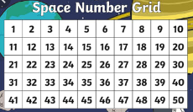
count up to 50
I can count up to 50.
I can count back from 50.
Reviewing …
Can you find other ways to record the numbers in the whole- part model?
Can you create whole-part model for the following scores?
Red – 41
Blue – 48
Green – 32
Yellow - 27
Notes:
Do this activity a few times. Each time ask the children to write the number. Ensure the children record numbers correctly. Ask the chn to tell you how many tens, how many ones?

Slide 2
count up to 50
I can count up to 50.
I can count back from 50.
Notes:
Do this activity a few times. Each time ask the children to write the number. Ensure the children record numbers correctly. Ask the chn to tell you how many tens, how many ones?

Slide 3
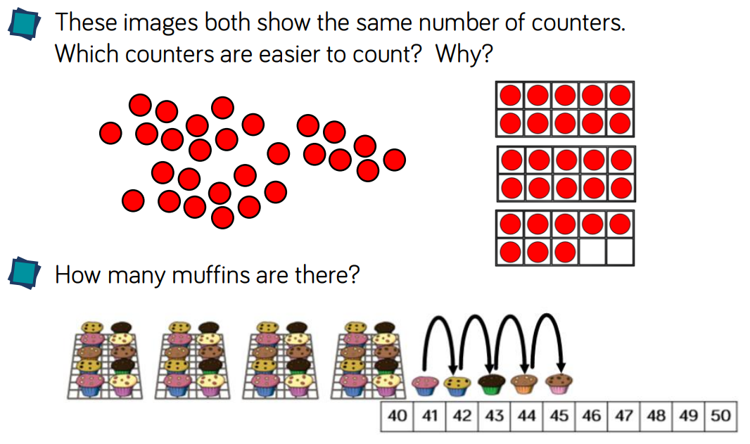
count up to 50
I can count up to 50.
I can count back from 50.
Notes:
Do this activity a few times. Each time ask the children to write the number. Ensure the children record numbers correctly. Ask the chn to tell you how many tens, how many ones?

Slide 4
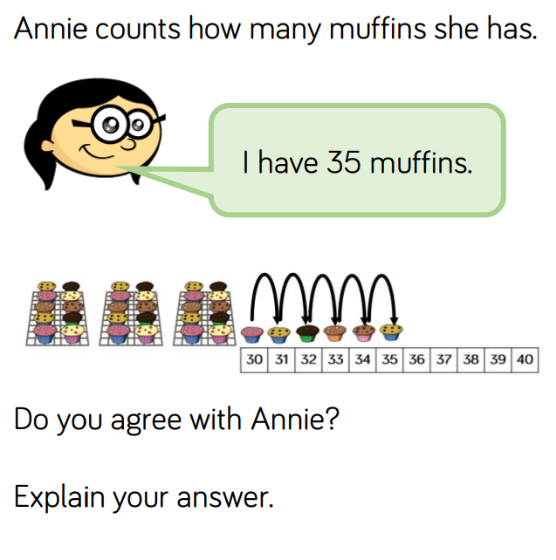
count up to 50
I can count up to 50.
I can count back from 50.
Notes:
Do this activity a few times. Each time ask the children to write the number. Ensure the children record numbers correctly. Ask the chn to tell you how many tens, how many ones?

Slide 5
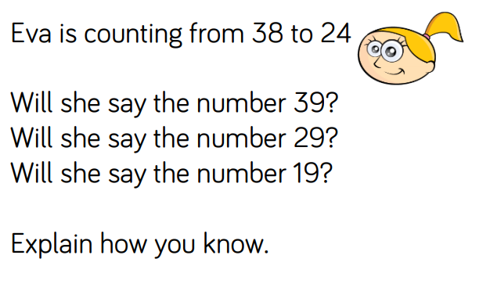
count up to 50
I can count up to 50.
I can count back from 50.
Notes:
Do this activity a few times. Each time ask the children to write the number. Ensure the children record numbers correctly. Ask the chn to tell you how many tens, how many ones?

Slide 6
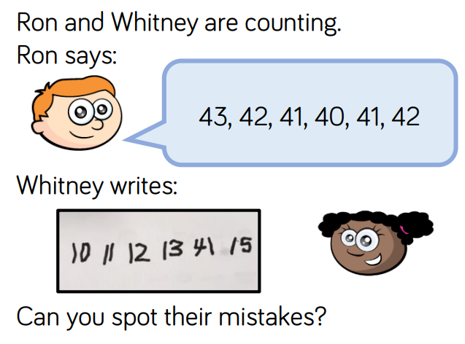
count up to 50
I can count up to 50.
I can count back from 50.
Notes:
Do this activity a few times. Each time ask the children to write the number. Ensure the children record numbers correctly. Ask the chn to tell you how many tens, how many ones?

