Slide 1
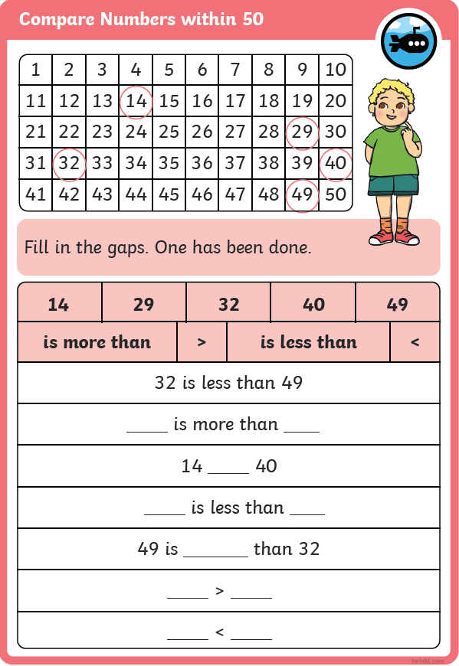
counting in 2s.

Slide 2
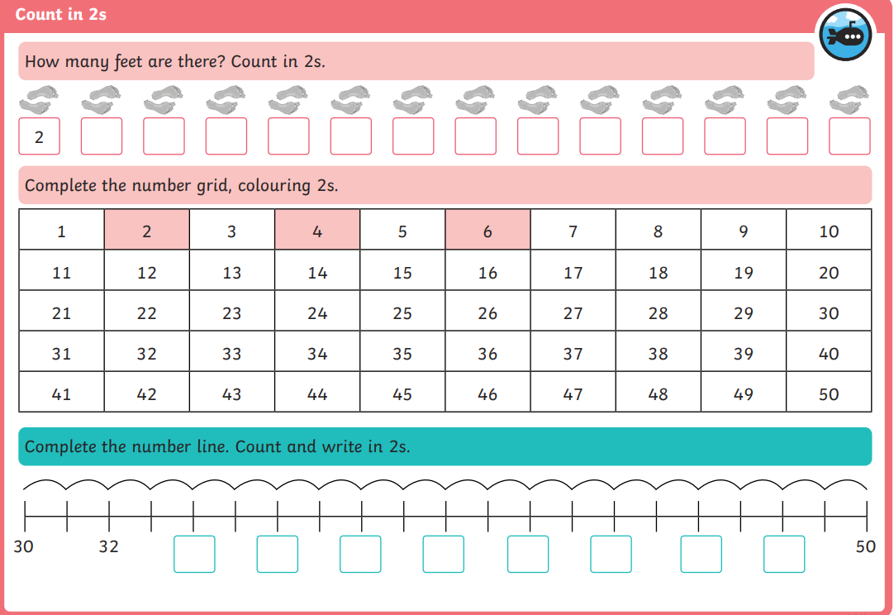
counting in 2s.

Slide 3
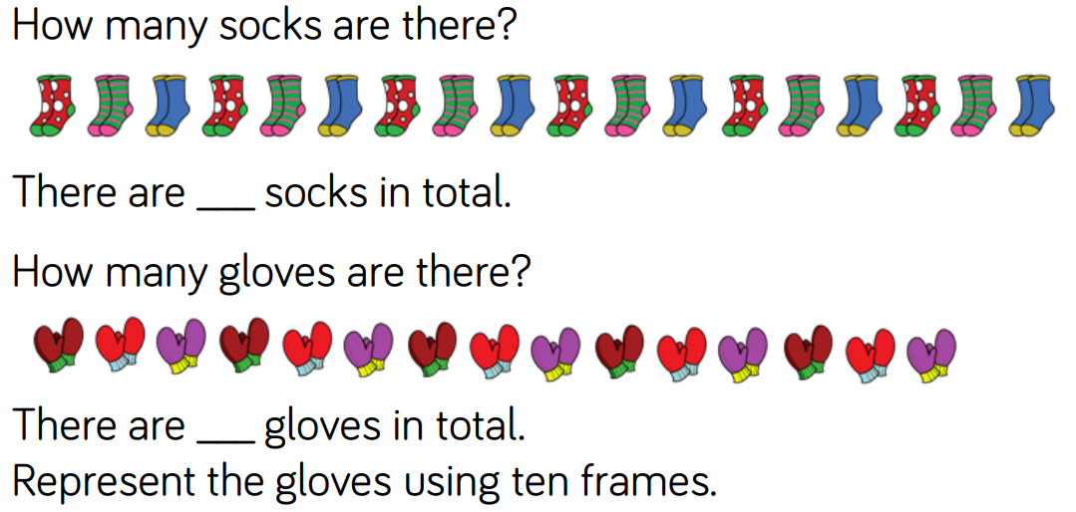
counting in 2s.

Slide 4
counting in 2s.

