Slide 1
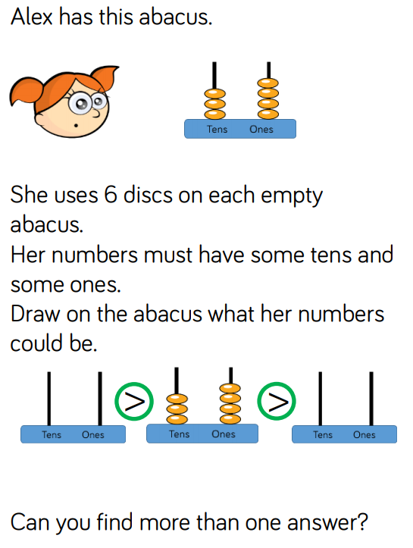
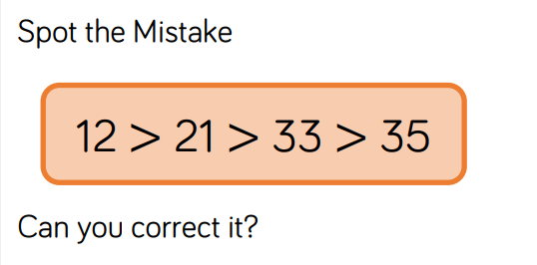
counting in 2s.
Warm up:

Slide 2
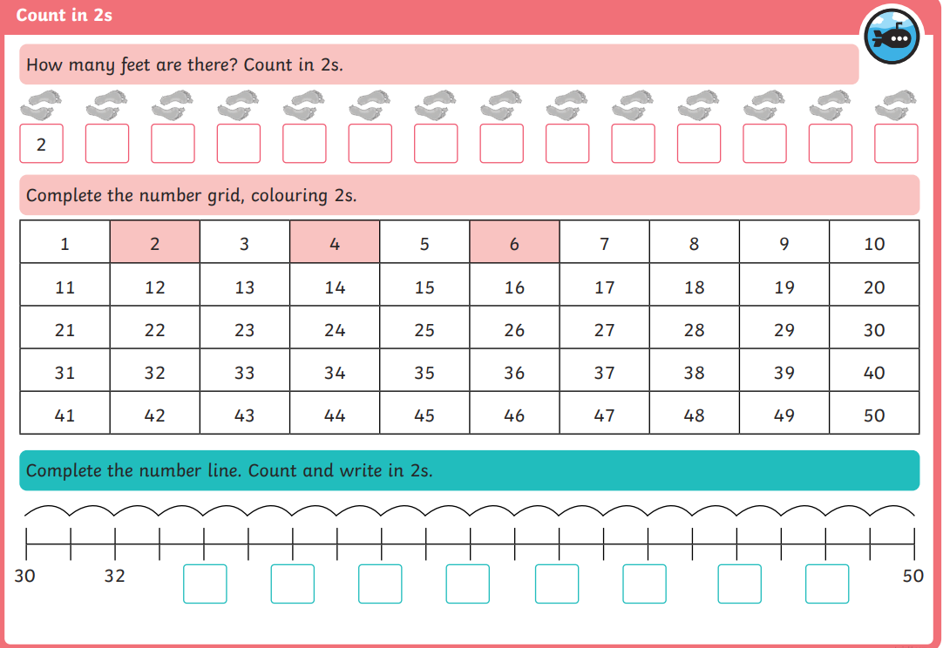
counting in 2s.

Slide 3
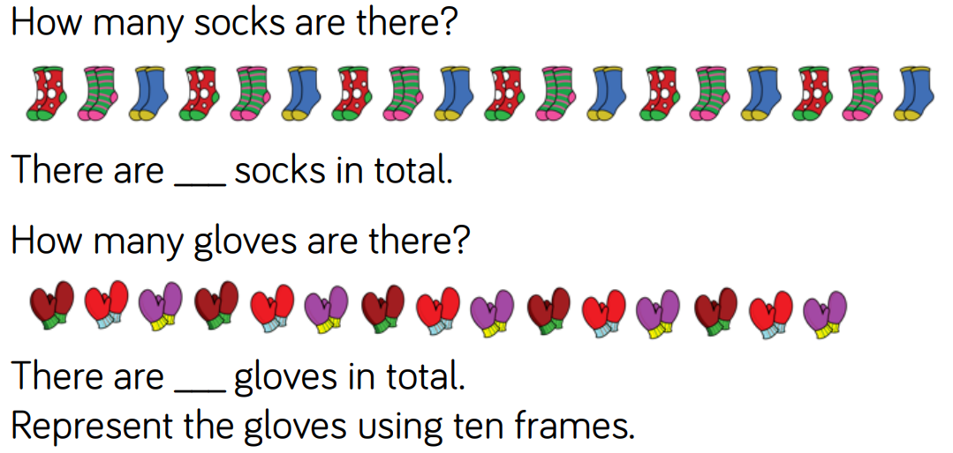
counting in 2s.

Slide 4
counting in 2s.

Slide 5
counting in 2s.

