Slide 1
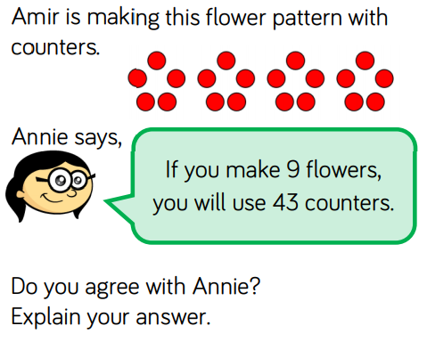
counting in 5s.

Slide 2
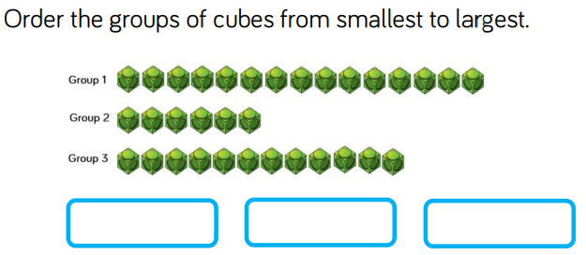
Order numbers 50.

Slide 3
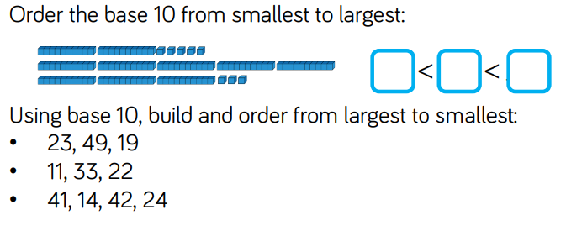
Order numbers 50.

Slide 4
Order numbers 50.

