Slide 1
Addition and Subtraction Word Problems
WALT: Solve number problems
WILF: Make sure I understand the question; Represent the problem using number
sentences, statements or diagrams or a calculation; Decide which calculation I need to do to answer the question

Slide 2
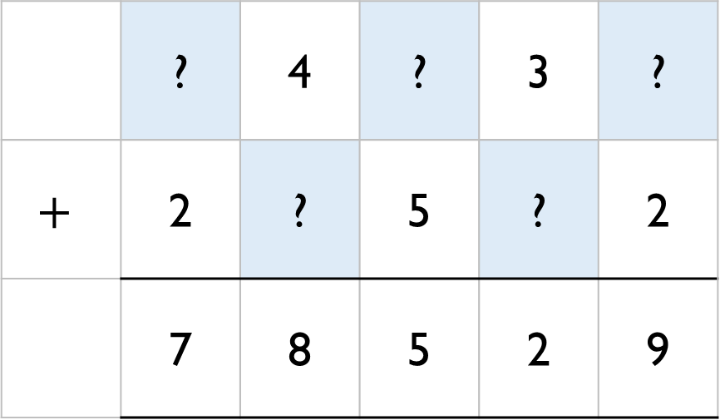
Warm Up
Can you work out the missing numbers.
 | ? | 4 | ? | 3 | ?
$$+$$ | 2 | ? | 5 | ? | 2
 | 7 | 8 | 5 | 2 | 9

Slide 3
Warm Up
Rosie completes this subtraction incorrectly.
Explain the mistake to Rosie and correct it for her.
2 8 7 0 1
7 6 2 1
2 1 1 8 0

Slide 4
Worded Problems – Addition and Subtraction
A milkman has 250 bottles of milk.
He collects another 160 from the dairy, and delivers 375 during the day.
How many does he have left?

Slide 5
Mo, Whitney, Teddy and Eva collect marbles.
Mo
Whitney
Teddy
In total they have 8,524 marbles between them.
How many does Eva have?
I have 1,648 marbles.
I have double the amount of marbles Mo has.
I have half the amount of marbles Mo has.

Slide 6
Worded Problems – Addition and Subtraction
Eva and Mo both make up a 4-digit number.
The difference between their numbers is 3,465
What could their numbers be?

Slide 7
On Monday, Whitney was paid £114
On Tuesday, she was paid £27 more than on Monday.
On Wednesday, she was paid £27 less than on Monday.
How much was Whitney paid in total?
How many calculations did you do?

