Slide 1
Can you make a word list for one of these sounds?
ow | oa | o-e
know

Slide 2
Thursday 4th February 2021
Today we will…
Read a list of words.
Spell words from the list.
Continue reading the story and answer questions.

Slide 3
when
three
just
follow
street
throw
own
yellow

Slide 4
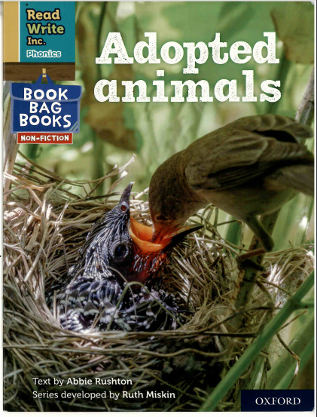

Slide 6
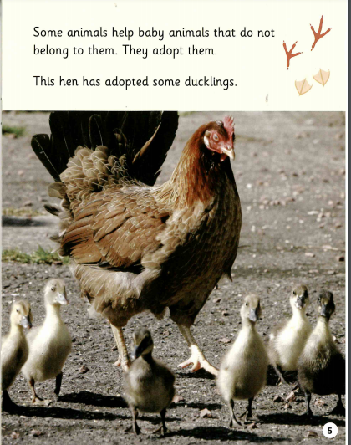
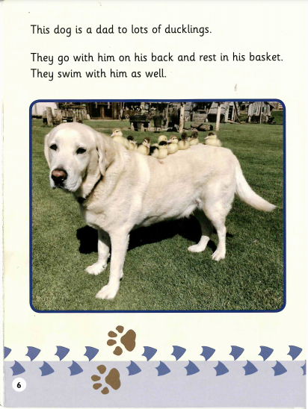

Slide 7
Read the following sentence and choose the correct ending.
The hen has adopted…
a lamb.
ducklings.
a squirrel.

