Slide 1
Hope you had a lovely break
Santorini class.
Welcome back to
online learning.

Slide 2
Online learning Rules.
Please make sure you log in to the lesson on time on each school day.
Always have a book, pencil, ruler etc to write with. A book will be good to use as your work can be stored together.
Please use your First own name and write the initial for your second name. This will be used to take the class register so make sure you put your proper name (no nicknames). E.g. John M
Do not unmute yourselves unless you are asked a question or type in the chat.
The chat is used to answer questions or if you need help.
To unmute yourself just click on the microphone mute icon.

Slide 3
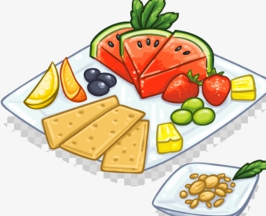
.
Break time:
Try to eat, drink or go to the toilet before or after the lesson.
If you are allocated to a breakout room then this is the group I would like TA to work with.
Please do not have the TV or any other devices on, in the background and try to work in a quiet area so you can limit any distractions for you and for others when you are unmuted. If you are in school remain unmuted unless asked by adult to unmuted.
When I am sharing my screen I am no longer able to see all of you at the same time. This means that I will randomly choose someone to answer.
Please ensure you are at your screen.

Slide 5
Recap on previous knowledge
What makes a good sentence?

Slide 7
WALT: To be able to read and write different forms of sentences. WILF: To read a statement and check for sense by rereading the sentence. To know and write a statement and use the correct punctuation.

Slide 8
A simple sentence is
a statement.
So what is a statement?

Slide 9
Statements
1
Statements are sentences which tell you a fact, opinion or idea.
Example:
A rainbow has 7 colours.
They are beautiful to look at.

Slide 10
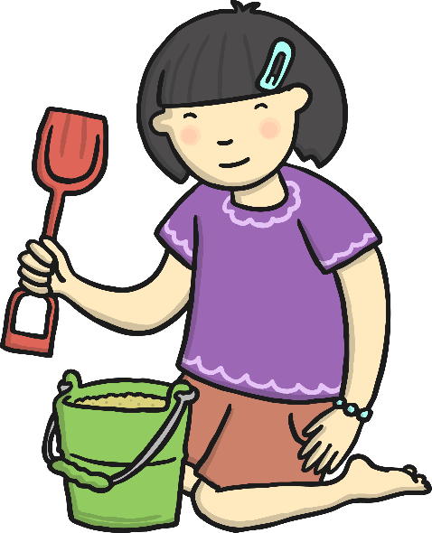
What Can You See?
Let’s look at some examples
Can you say what you can see in a full sentence?
There are lots of different ways you can say what you can see:
I can see...
A girl has a brown spade and a green bucket.
The happy girl is playing in the sand with her spade and bucket.

Slide 11
What Does a Sentence Need?
Below is a full sentence. Why is it a good sentence?
It is a good sentence because:
It has finger spaces between each word;
It starts with a capital letter
It makes sense when you read it.
The girl has a spade and a green bucket.
It end with a full stop;

Slide 12
What Is She Doing?
Your turn:
Can you say what the lady is doing in a full sentence?
Can we write down what the lady is doing in a full sentence?

Slide 13
What Does your Sentence have?
Let’s check your sentence
Is your sentence a full sentence? Can you tell your adult why?
The lady is shopping for food.
It is a good sentence because:
It starts with a capital letter;
It has finger spaces between each word;
It end with a full stop;
It makes sense when you read it.

Slide 14
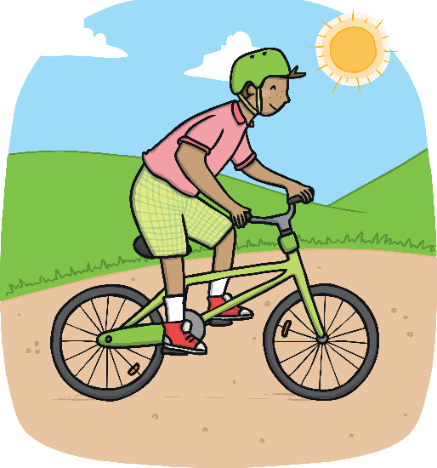
Can We Write a Sentence?
Can you say what the boy is doing in a full sentence?
Now write down the sentence.
Remember what a sentence needs to have.

Slide 15
Now You Try!
Can you finish off these sentences?
The boy ________________________________.

Slide 16
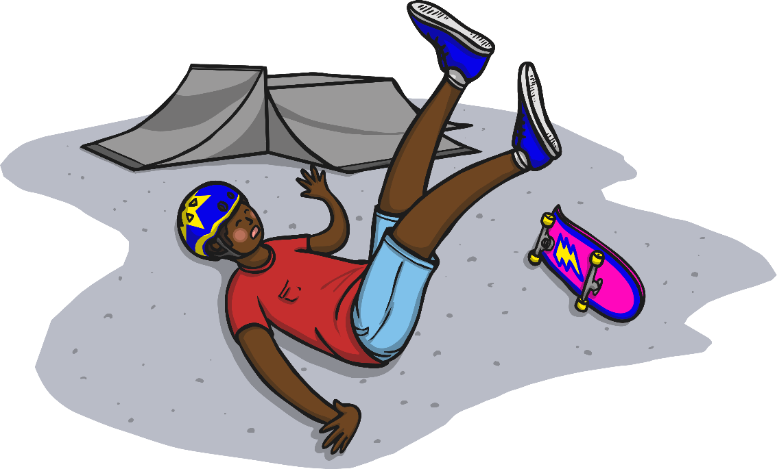
Now You Try!
Can you finish off these sentences?
Ben _____________________________________.

Slide 17
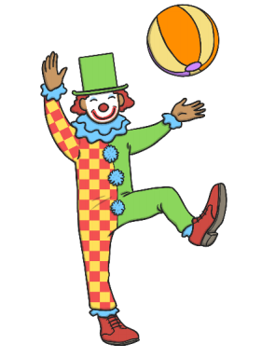
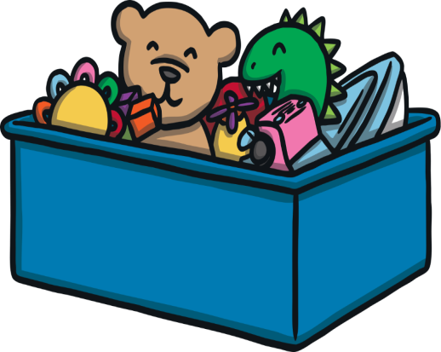
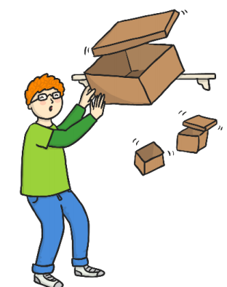
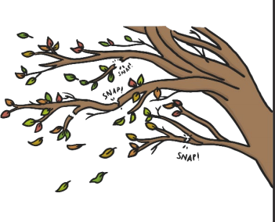
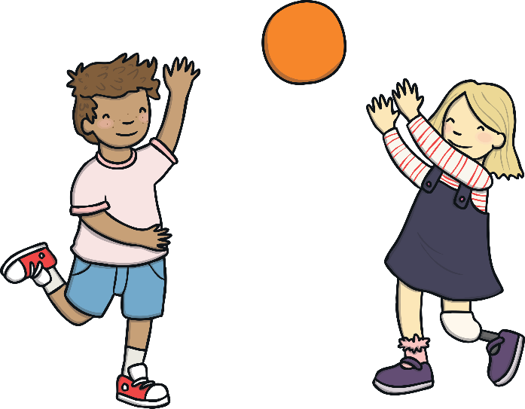
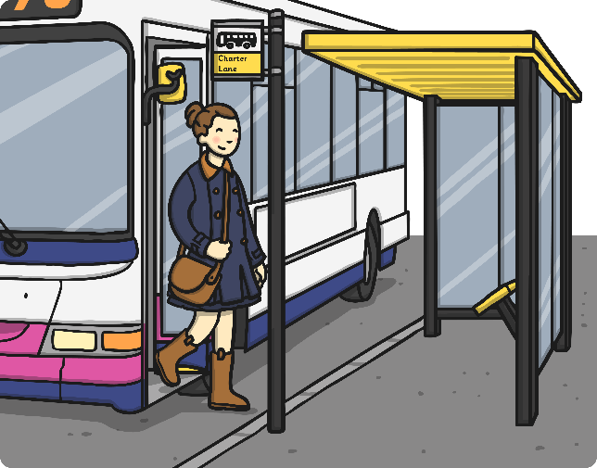
Activity: What can you see? Complete the sentence.
Jane .....
The clumsy...
The teddy....
The boxes ...
What can you see? Write a full sentence to match the picture.

Slide 18
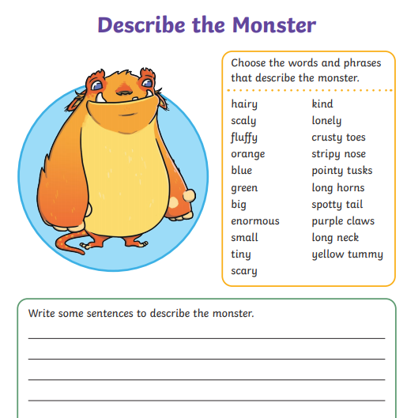
Extension: Use the word bank to help you write some sentences .

Slide 19
Miss Beaton Group: What can you see? Complete the sentence.
The boxes ...........
Jane .....
The teddy....
What can you see? Write a full sentence to match the picture.

Slide 20
Plenary

Slide 21
What have you learnt?
Success Criteria
To write a statement.
To reread the statement to check for sense.
To include finger space as I am writing a sentence.
To check that the statement begins with a capital letter and ends with full stop.
To make sure my letters are of a consistent size and they are sitting on the line.

