Slide 1
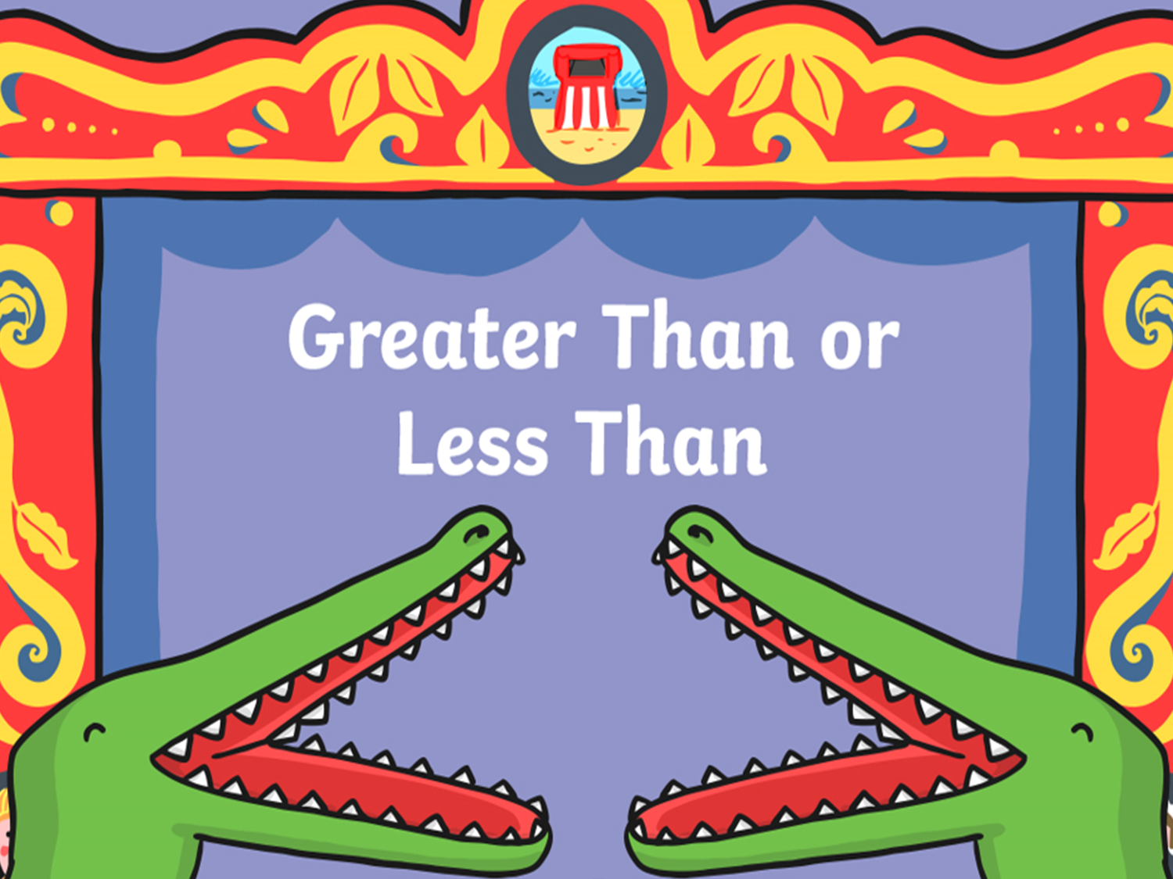
Comparing Numbers

Slide 3
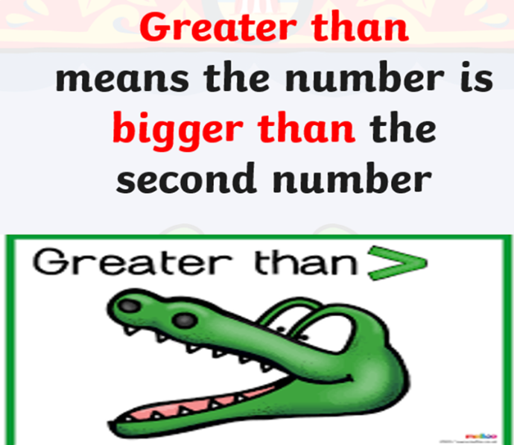
RECAP
Today we are going to be using our subtracting skills then compare the numbers.

Slide 4
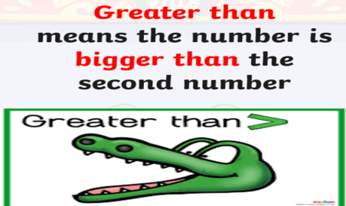
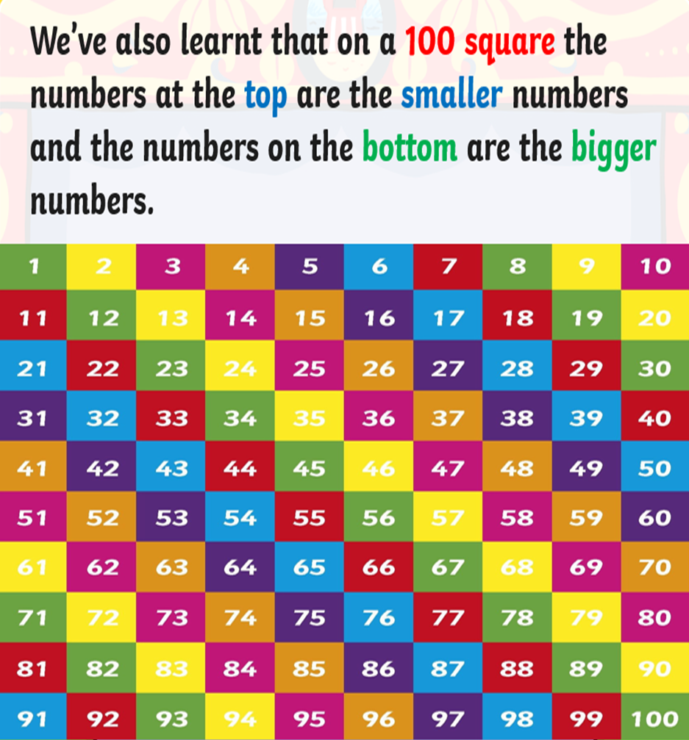
RECAP
What skills do you need when subtracting (taking away)?
When you are subtracting:
Remember
You are counting back wards on the number square from the biggest number.
Skills:
Find the biggest number on your number square.
If you are jumping in tens – move upwards on the number square.
If you are counting in ones, moves across to the left on the number square.

Slide 5
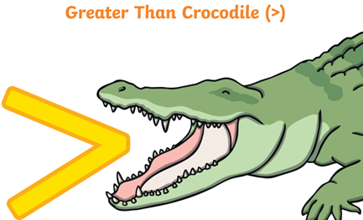
GREATER THAN
First step: (50-10) …..20
Remember:
You subtract the numbers first then compare the answer with the second number)
Find 50 on your number sq. Jump back 10 . What is your answer?
(50-10=40) …… 20
(40) > 20

Slide 6
Find 22 on your number square then subtract 7.
(22-7=) …. 5
You subtract the numbers first then compare the answer with the second number).
Find 22 on your number square.
Count back 7.
What is your answer?
Now Compare the answer with the second number
? …… 5
What symbol will go in the middle?

Slide 7
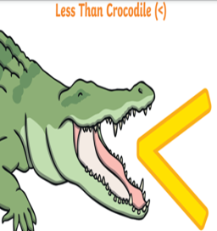
(65-30 )…. 45
You subtract the numbers first then compare the answer with the second number).
Find 65 on your number square.
Count back 30.
What is your answer?
Now Compare the answer with second number
? …… 45
What symbol will go in the middle?

Slide 8
Put your finger on the number 100. Jump backwards 22 squares to subtract.
(100-22=) … 100
You subtract the numbers first then compare the answer with the second number).
Find 100 on your number square.
Count back 22.
What is your answer?
Now Compare the answer with second number
(?) … 100
What symbol will go in the middle?

Slide 9
Put your finger on the number 50. Jump backwards 25 squares to subtract.
(50-25=) ……. 25
You subtract the numbers first then compare the answer with the second number).
Find 50 on your number square.
Count back 25.
What is your answer?
Now Compare the answer with second number
? …… 25
What symbol will go in the middle?

Slide 11
Which symbol is it?
(37-20=)…….8
Explain your answer.

Slide 12
Which symbol is it?
37-20=17 > 8
Explain your answer.

Slide 13
Which symbol is it?
(20-10=)… 10
Explain your answer.

Slide 14
Which symbol is it?
20-10=10 = 10
Explain your answer.

Slide 15
Which symbol is it?
(80-15=)…..70
Explain your answer.

Slide 16
Which symbol is it?
80-15=65 < 70
Explain your answer.

Slide 17
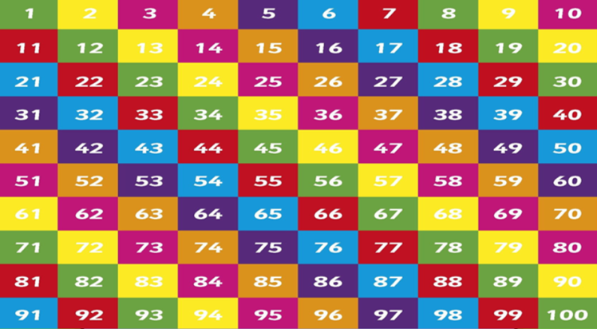
You have just learnt how to subtract using a 100 Square and compare numbers.
Now try these subtraction number bonds but
REMEMBER the crocodile will always eat the biggest number!

Slide 19
18 – 7=
19 - 5 =
12 - 6 =
11- 5 =
18 - 2=
15-9 =
68 -43 =
100-54 =
70 - 13=
45-23 =
16 - 14 =
27 - 13 =
99 -31 =
100-0=
?
?
?
?
?
?
?
?
?
?
?
?
?
?
50
18
2
45
15
7
5
46
59
21
50
13
67
100
Which symbol should go in the middle?

Slide 20
Miss Beaton’s Group
Which symbol should go in the middle?
Subtract | Symbol
(10-8=) | ? | 7
(15-5=) | ? | 10
(50-20=) | ? | 20
(45-20=) | ? | 15
(70-40=) | ? | 30
(100-30=) | ? | 90
(80-20=) | ? | 70

Slide 21
18 – 7= 11
19 - 5 = 14
12 - 6 = 6
11- 5 = 6
18 - 2= 16
15-9 = 6
68 -43 = 25
100-54 = 46
70 - 13= 57
45-23 = 22
16 - 14 = 2
27 - 13 =14
99 -31 = 68
100-0= 100
<
<
>
<
>
<
>
=
<
>
<
>
>
=
50
18
2
45
15
7
5
46
59
21
50
13
67
100
Check your answers!

Slide 23
Plenary
I was in a rush and made some mistakes.
Check my answers and correct.

Slide 24
Check your answers!

Slide 25
What did you learn today?

