Slide 1
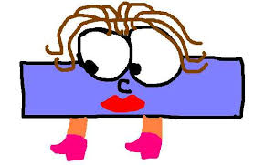
To subtract using a 100 Square by counting in 10s or 1s.

Slide 2
WALT: Subtract using a 100 Square by counting backwards in 10s or 1s.
WILF:
To be able to count backwards in 10s and 1s using a 100 square to subtract.
Recognise the place value of numbers on a 100 square.

Slide 3
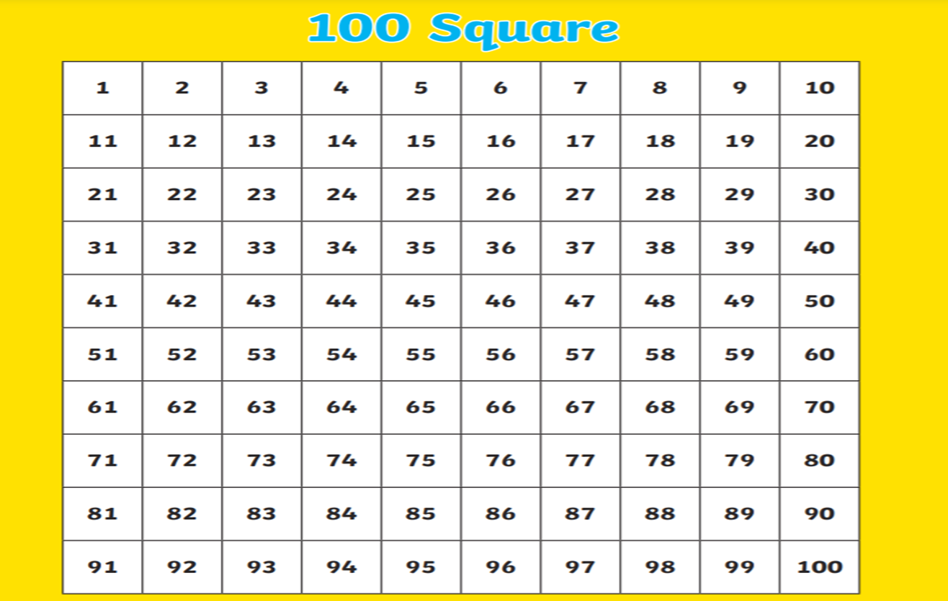
When we use a 100 Square to subtract we must count backwards from a given number.
Recap
For example….

Slide 4
When we are subtracting numbers, the total reduces (it gets smaller!) This is because we are taking a smaller number away from a bigger number.
Recap
It’s impossible to take 9 from 6 because 6 is smaller than 9.
What do I mean?
6-9 =
9-6 = 3

Slide 5
Counting backwards in tens: You are going up the number square when you counting in 10s.
Recap
Counting backwards in ones:
You are going towards the left
when counting in 1s.

Slide 6
Let’s go through some examples with Jumping back in ones.

Slide 7
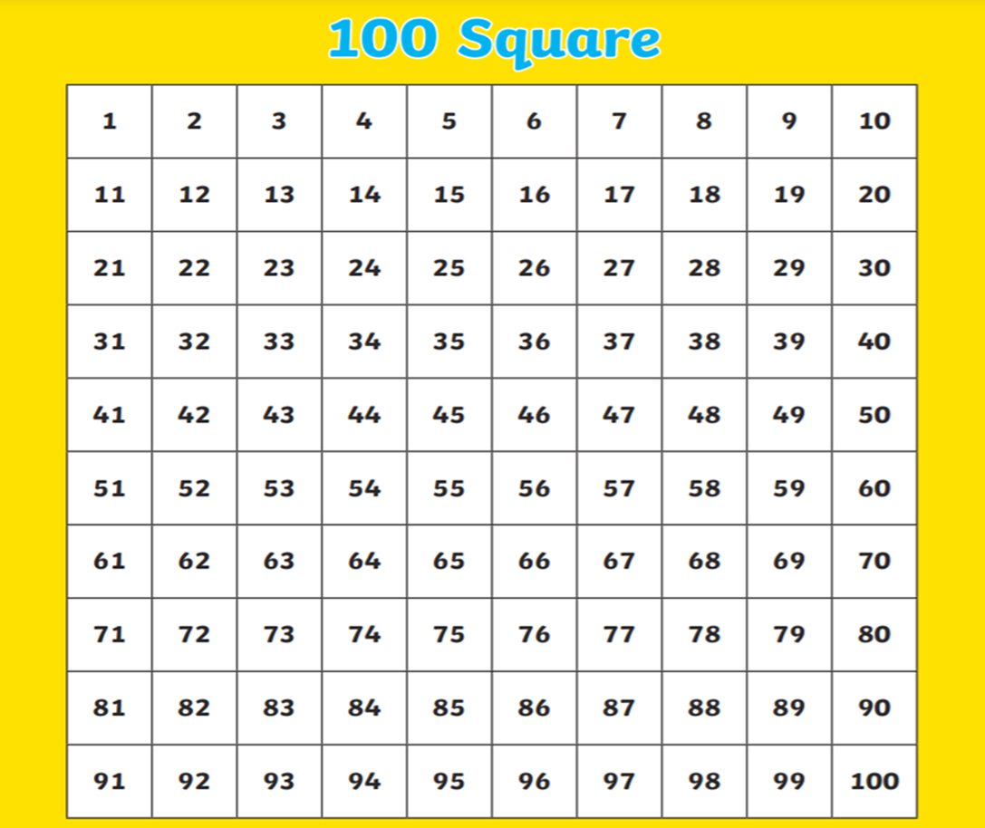
When find the bigger number on the number square .
Then we jump back wards using the smaller number.
Recap
For example;
Put your finger on 28 and then move backwards 8 squares.
28-8=20

Slide 8
When find the bigger number on the number square .
Then we jump back wards using the smaller number.
Your Turn
For example;
Put your finger on 68 and then move backwards 9 squares.
68-9=??

Slide 9
Let’s go through some examples with counting back in 10s.

Slide 10
Recap
Put your finger on 86, jump back one big jump.
Why? Because we know that we are counting 10s
T
O
86-30=56

Slide 11
Now your turn
Put your finger on 94, jump back.
How many jumps are you jumping back?
Show your adult.
T
O
94-30=??

Slide 12
Let’s make it harder! Try to Jump back in tens then ones.

Slide 13
Put your finger on 73 and then move up 3 square to 43.
You have now subtracted 30.
Now move backwards 5 squares to subtract the 5s.
T
O
73-35=38

Slide 14
Put your finger on the bigger number.
First jump back in 10s.
Now move across counting backwards to subtract the ones.
T
0
86-54=??

Slide 15
Quick practice
38-18=
59-26=
88-61=
98-56=
85-40=
100-45=

Slide 16
Your Challenge. Use the 100 Square to calculate the number bonds and REMEMBER the RULES!

Slide 17
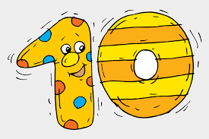
Now it’s your turn to try some examples. Remember to use the 100 Square to help you and remember the rules!

Slide 18
Activity
mild | Hot | Spicy
24-10= | 45-13= | 80 - 56 =
23-12= | 40-10= | 85 - 55 =
44-13= | 54-24= | 70-35 =
75-22= | 65-30= | 100 – 69 =
57-25= | 68-35= | 93 - 67 =
46-22= | 69-36= | 100 - 53 =
27-14= | 73-41= | 99- 35 =
42-12= | 77-45= | 96-68 =
50-20= | 76-51= | 90 - 47 =
55-30= | 89-61= | 100- 55=

Slide 19
Miss Beaton:
Have a go at jumping back in 1s.
Now try to jump back in 10s.
15 - 9= | 36 - 4 = | 44 - 20 =
20 - 8 = | 55 - 5 = | 60 - 20 =
22 - 5 = | 59 - 10 = | 58 – 30 =
24- 6 = | 79-10 = | 75 - 30 =
38-7= | 73-10= | 86-30=
Extension
Can you think of a subtraction number sentence your group can work out on the number square?

Slide 20
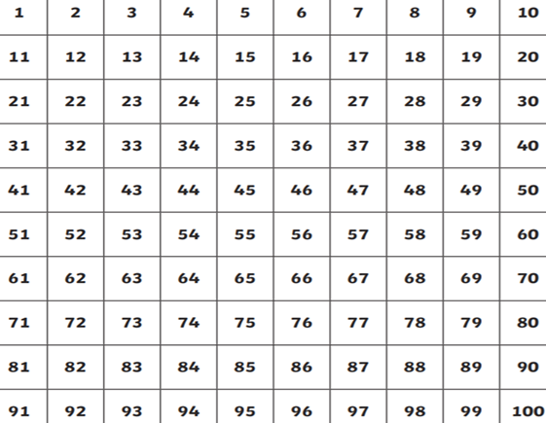
When we are subtracting the numbers get smaller! This is because we are subtracting a smaller number away from a bigger number. When we use a 100 Square to subtract we can go up to subtract in 10s. Or go backwards to count is 1s. The further up you move the smaller the number is. The further backwards you go the smaller the number is in 1s.
Plenary

