Slide 1
To Add and Subtract using a 100 Square by counting in 10s or 1s.

Slide 2
Recap
We’ve learnt that when we use a 100 Square to add we can go down to count in 10s.Or go across to count in 1s and the numbers will get bigger.
We’ve also learnt that the further up on the 100 Square you go the smaller the number gets. The further backwards on a 100 Square you go the smaller the number also gets!

Slide 3
WALT:Add and Subtract using a 100 Square by counting in 10s or 1s.
WILF:
To be able to count forwards and backwards in 10s and 1s using a 100 square.
Understand the place value of numbers on a 100 square.

Slide 4
When we are adding the numbers get bigger! This is because we are adding two groups altogether.
12
+
6
12+6 =18

Slide 5
When we are adding you can even swap the numbers around and the answer will still be the same. They will still get bigger! This is because we are adding two groups altogether.
6
+
12
6+12 =18

Slide 6
BUT……

Slide 7
When we are subtracting the numbers get smaller! This is because we are taking away a smaller number from a bigger number.
-
12-6 =6
6-12=

Slide 8
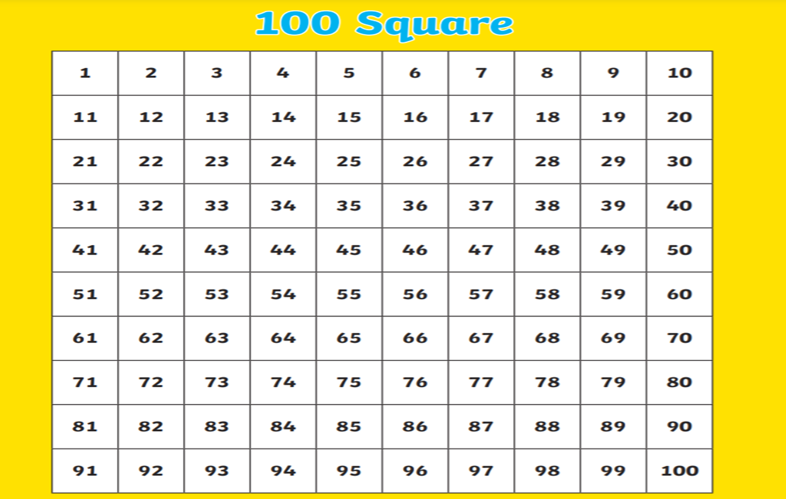
When we use a 100 Square to subtract we must go up (backwards) to count in 10s. Or go backwards to count is 1s.
For example….

Slide 9
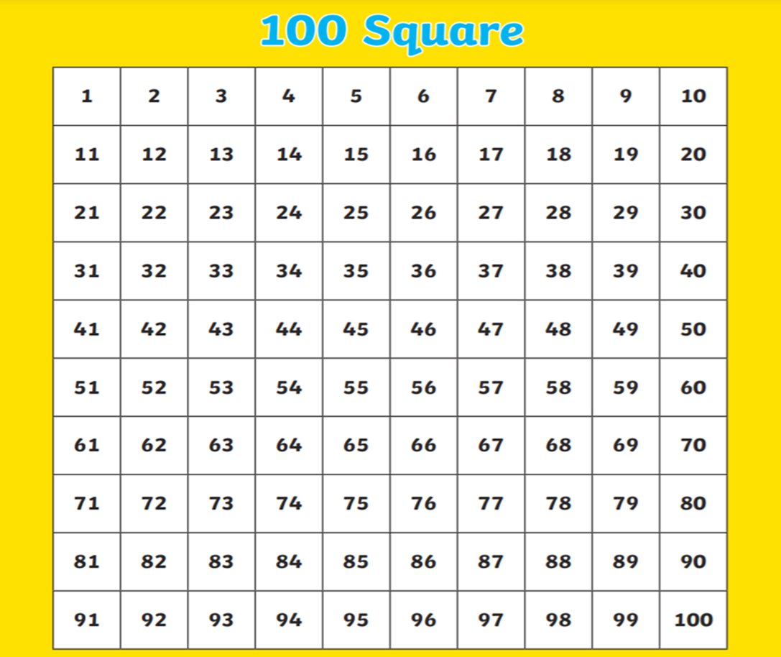
Put your finger on 24 and then move backwards 8 squares.
24-8=16

Slide 10
Put your finger on 33 and then move up 1 square to 23. You have now subtracted 10.
Now move backwards 2 squares to subtract the 1s.
33-12=21

Slide 11
Put your finger on 48 and then move up 2 squares to 28. You have now subtracted 20.
Now move backwards 3 squares to subtract the 3s.
48-23=25

Slide 12
But what about when we’re Adding!!! Lets go through some examples.

Slide 13
Put your finger on 17 and then move across 9 squares to 26. You have now added 9.
17+9=26

Slide 14
Put your finger on 18 and then move down 2 squares to 38. You have now added 20.
18+20=38

Slide 15
Put your finger on 38 and then move down 1 square to 48. You have now added 10.
Now move across 5 squares to 53. You have now added the 5s.
38+15=53

Slide 16
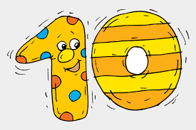
Now it’s your turn to try some examples. Remember to use the 100 Square to help you and remember the rules!

Slide 17
22+8=
19+12=
50-21=
32-16=
70-28=
6.60-40=

Slide 18
YOUR CHALLENGE AWAITS YOU!!!! Use the 100 Square to calculate the number bonds and REMEMBER the RULES!

Slide 19
15 + 10= | 20 - 4 = | 24 + 18 =
20 + 9 = | 25 - 10 = | 30 + 14 =
13 + 8 = | 15 - 13 = | 22 – 16 =
14 + 11 = | 17 -9 = | 19 - 12 =
22-8= | 55+23=
18+9= | 80-50=
42-3= | 24+24=
75+22= | 45-33=
50-10= | 70+16=
46+32= | 42-18=
29-20= | 45+15=
22+38= | 16-16=
56-40= | 28+31=
33+50= | 90-20=

Slide 20
Plenary
We’ve learnt that when we use a 100 Square to add we can go down to count in 10s.Or go across to count in 1s and the numbers will get bigger.
The further up on the 100 Square you go the smaller the number gets. The further backwards on a 100 Square you go the smaller the number also gets!
We also learnt that when we are adding the numbers can be swapped around and the answer will always be the same.
BUT when we are subtracting you can only take a smaller number away from a bigger number and numbers can’t be swapped!

