Slide 1
Maths
Fractions
Year One
Maths | Year 5 | Fractions | Decimal Problem-Solving | Lesson 1 of 1: Decimal Addition and Subtraction

Slide 3
Aim
I can solve problems involving decimals.
Success Criteria
I can read and write numbers with up to three decimal places.
I can solve problems by adding and subtracting decimals, including regrouping and exchanging.
I can solve problems by adding and subtracting decimals with a different number of decimal places.

Slide 4
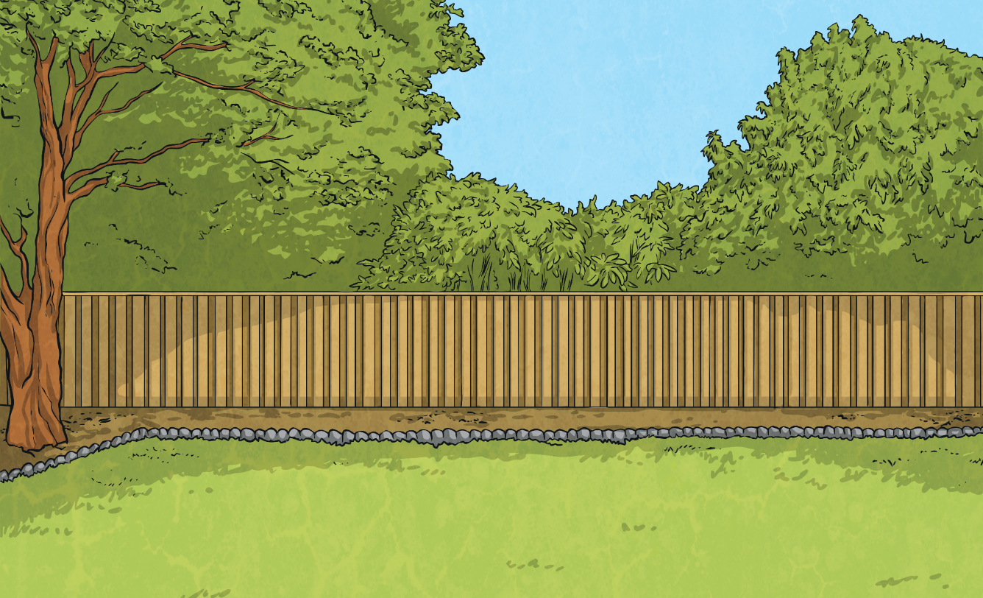
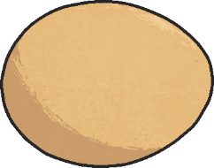
Decimal Number Sequences
Identify how the decimal number sequence is increasing or decreasing. This is called the term-to-term rule.
?
?
?
- 0.4
- 0.4
- 0.4
- 0.4
- 0.4
2.8
2.4
2
?
1.6
?
1.2
?
0.8
What will the next three numbers in the sequence be?

Slide 5
Decimal Number Sequences
Identify how the decimal number sequence is increasing or decreasing. This is called the term-to-term rule.
?
?
?
- 0.3
- 0.3
- 0.3
- 0.3
- 0.3
5.8
5.5
5.2
?
4.9
?
4.6
?
4.3
What will the next three numbers in the sequence be?

Slide 6
Decimal Number Sequences
Identify how the decimal number sequence is increasing or decreasing. This is called the term-to-term rule.
?
?
?
+ 0.07
+ 0.07
+ 0.07
+ 0.07
+ 0.07
9.88
9.95
10.02
?
?
?
10.09
10.16
10.23
What will the next three numbers in the sequence be?

Slide 7
Decimal Number Sequences
Identify how the decimal number sequence is increasing or decreasing. This is called the term-to-term rule.
?
?
?
+ 5.1
+ 5.1
+ 5.1
+ 5.1
+ 5.1
3
8.1
13.2
?
18.3
23.4
?
28.5
?
What will the next three numbers in the sequence be?

Slide 8
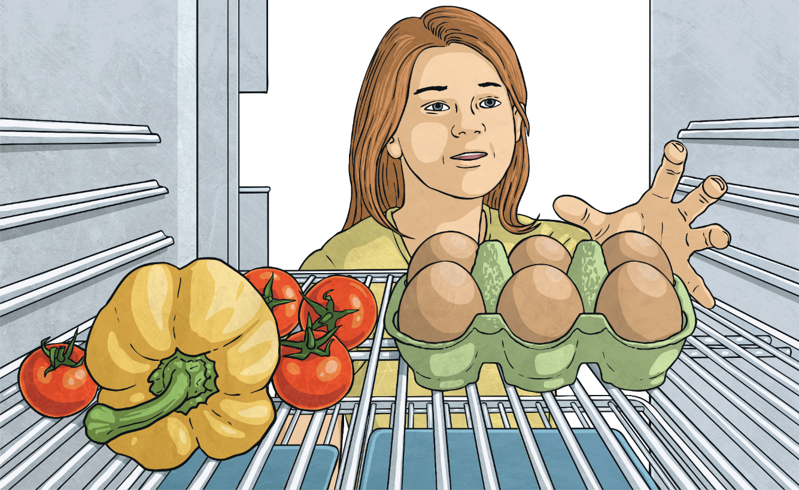
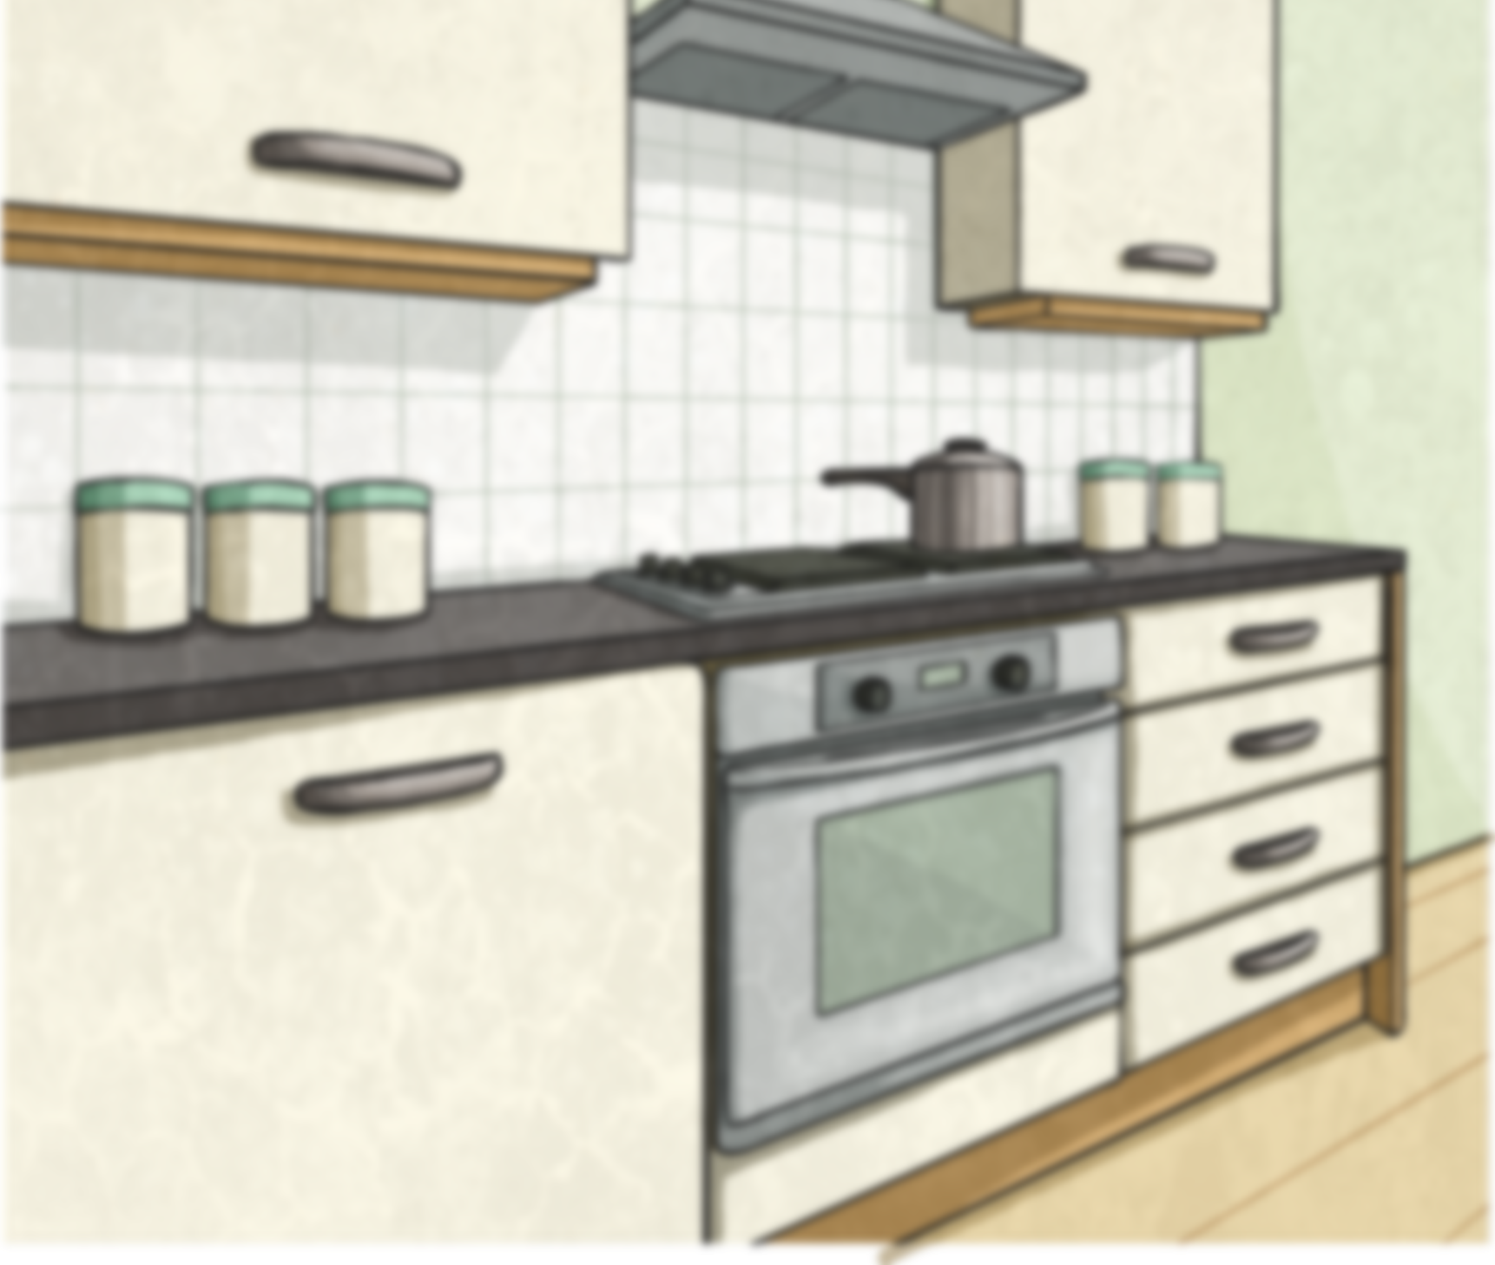
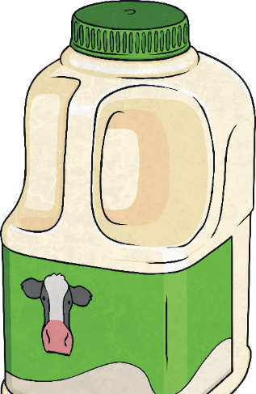
Adding Decimals
When we add decimal numbers, we can use a place value to grid to help us.
0.314 + 0.223 =
0.537
Ones | Tenths | Hundredths | Thousandths
0
5
3
7
Key
0.1
0.01
0.001

Slide 9
Adding Decimals
When we add decimal numbers, we can use a place value to grid to help us.
0.384 + 0.273 =
0.657
Ones | Tenths | Hundredths | Thousandths
When we add the hundredths together, we have. How can we regroup these?
15
100
0
6
3
7
Key
0.1
0.01
0.001

Slide 10
Adding Decimals Practice
Use a place value grid to add together one of these decimal calculations:
0.42 + 0.34
0.581 + 0.358
0.67 + 0.543
Show Answer
Show Answer
Show Answer
Ones | Tenths | Hundredths | Thousandths
Next

Slide 11
Adding Decimals Practice
0.42 + 0.34 =
0.76
Ones | Tenths | Hundredths | Thousandths
0
7
6
Key
0.1
0.01
Back

Slide 12
Adding Decimals Practice
0.581 + 0.358 =
0.939
Ones | Tenths | Hundredths | Thousandths
0
9
13
3
9
Key
0.1
0.01
0.001
Back

Slide 13
Adding Decimals Practice
1.213
0.67 + 0.543 =
Ones | Tenths | Hundredths | Thousandths
1
12
2
11
1
3
Key
1
0.1
0.01
0.001
Back

Slide 14
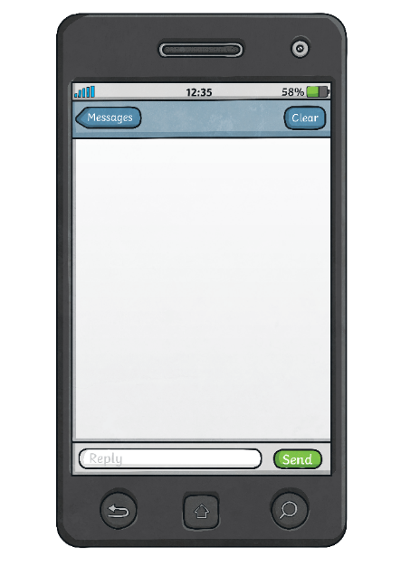
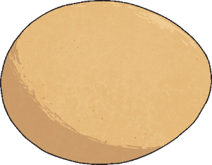
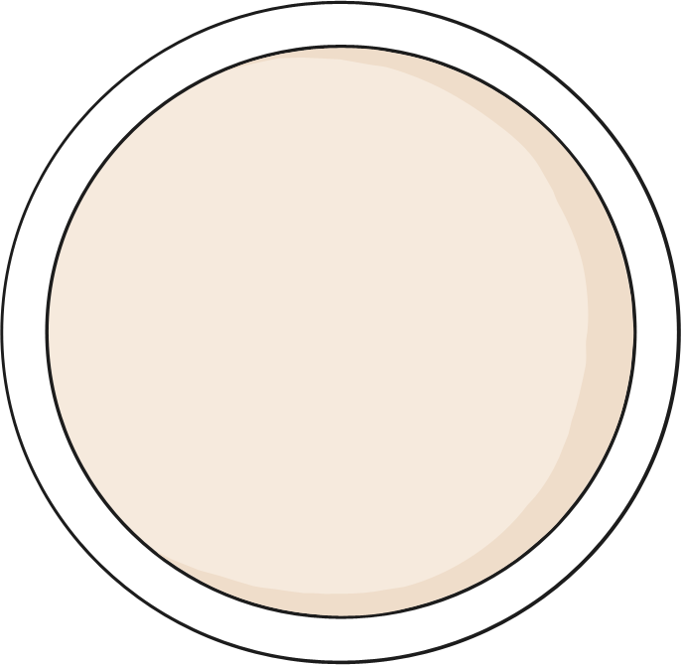
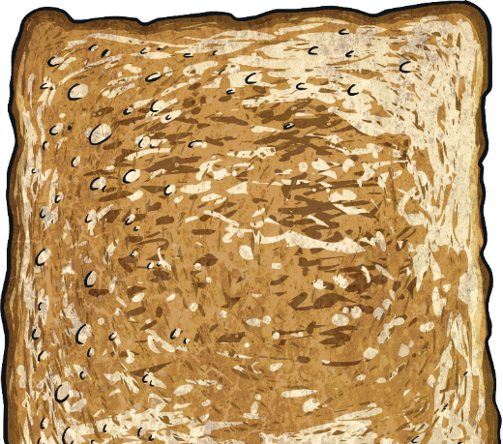
Subtracting Decimals
We can also use a place value grid to help us subtract decimal numbers.
0.314 - 0.223 =
0.091
Ones | Tenths | Hundredths | Thousandths
0
0
9
1
Key
0.1
0.01
0.001

Slide 15
Subtracting Decimals Practice
Use a place value grid to complete one of these decimal subtraction calculations:
0.42 - 0.34
0.581 - 0.358
0.67 - 0.543
Show Answer
Show Answer
Show Answer
Ones | Tenths | Hundredths | Thousandths
Next

Slide 16
Subtracting Decimals Practice
0.42 - 0.34 =
0.08
Ones | Tenths | Hundredths | Thousandths
0
0
8
Key
0.1
0.01
Back

Slide 17
Subtracting Decimals Practice
0.581 - 0.358 =
0.223
Ones | Tenths | Hundredths | Thousandths
0
2
2
3
Key
0.1
0.01
0.001
Back

Slide 18
Subtracting Decimals Practice
1.127
1.67 - 0.543 =
Ones | Tenths | Hundredths | Thousandths
1
1
2
7
Key
1
0.1
0.01
0.001
Back

Slide 19
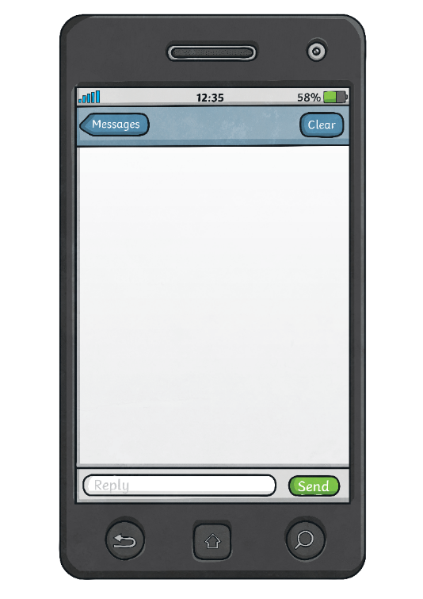
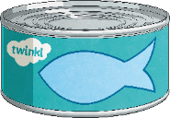
Decimal Calculation

Slide 20
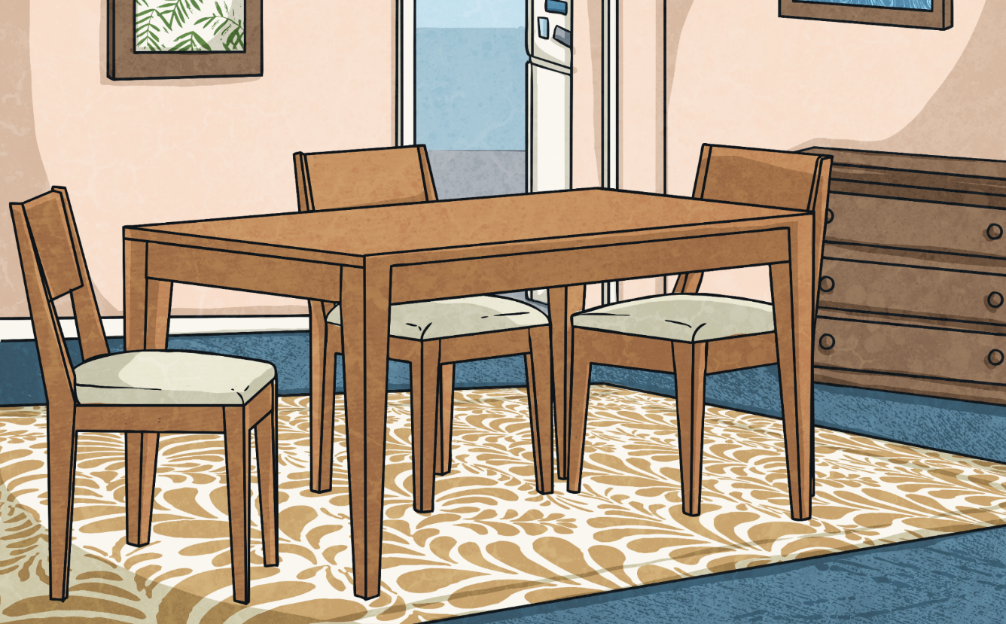
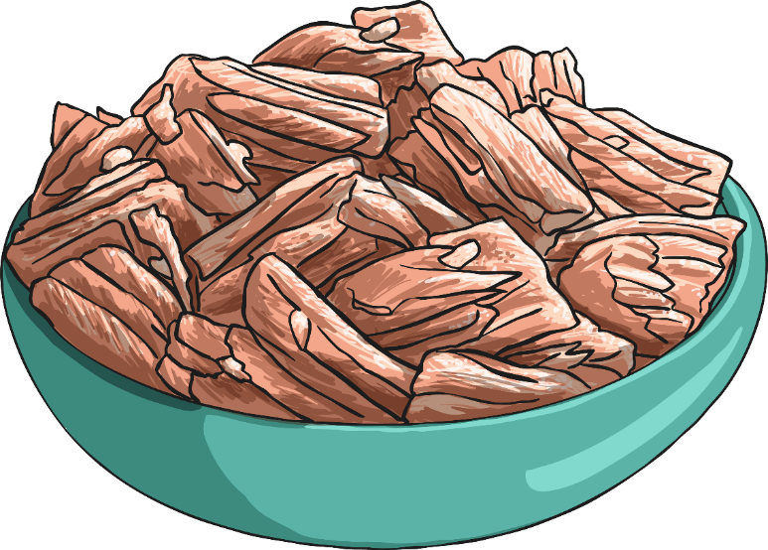
Decimal Calculation
Hand out the Circle Game Question Cards and sit or stand in a circle, facing inwards.
During each round, a number statement will be shown on the whiteboard. If the answer to the question on your card fits the statement, you have to swap places with another person whose answer fits the statement.

Slide 21
Circle Game
Round 4
Round 6
Round 5
Round 2
Round 3
Round 1
Change places if the answer to your question has an even ones digit.
Change places if the answer to your question has an odd ones digit.
Change places if the answer to your question has an odd tenths digit.
Change places if the answer to your question has an even tenths digit.
Change places if the answer to your question has an odd hundredths digit.
Change places if the answer to your question has an even hundredths digit.

Slide 22
Aim
I can solve problems involving decimals.
Success Criteria
I can read and write numbers with up to three decimal places.
I can solve problems by adding and subtracting decimals, including regrouping and exchanging.
I can solve problems by adding and subtracting decimals with a different number of decimal places.

