Slide 1
Can you make a word list for one of these sounds?
ew | oo | u-e
 | too

Slide 2
Monday 8th February 2021
Today we will…
Read a list of words.
Spell words from the list.
Continue reading the story and answer questions.

Slide 3
problem
wrong
spring
very
thanks

Slide 4
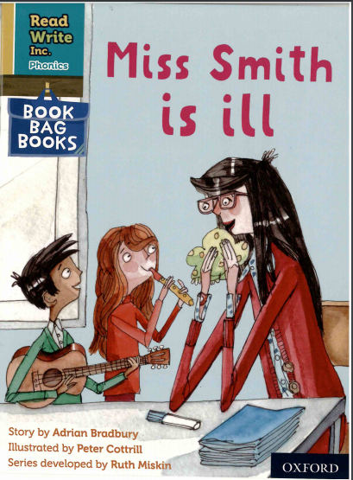

Slide 5
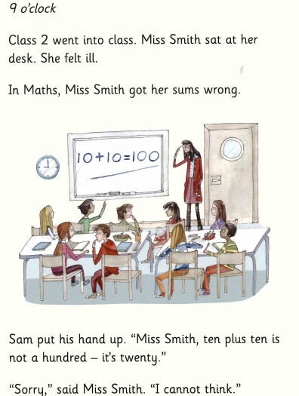

Slide 6
