Slide 1
What is a decimal point? What is a decimal number? You can type your answer/suggestions/guesses below.
WALT: divide by 10 using decimals
A decimal...

Slide 2
We know when we divide, the number gets smaller. We also learned that when we divide by 10 we move the number one space to the right and remove the zero, but, what happens if there is no zero to remove?
Type your suggestions below:
WALT: divide by 10 using decimals
I think….

Slide 3
All numbers have a decimal place (but we may not always see it!)
For example:
We would write 27 but it could also be written as 27.0. Both numbers are still the same value.
WALT: divide by 10 using decimals

Slide 4
What do you notice about the following sum?
27➗10=
WALT: divide by 10 using decimals
I notice...

Slide 5
Click on the link to watch the video
https://www.bbc.co.uk/bitesize/clips/zcnyr82
What does this video tell you about dividing by 10?
WALT: divide by 10 using decimals

Slide 6
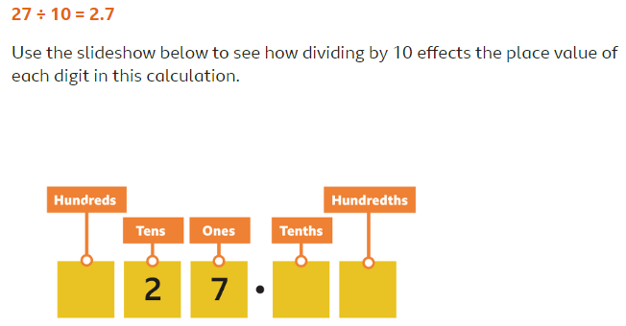
The digit in the tens column, moves to the ones and the digit in the ones column moves into the tenths column.
WALT: divide by 10 using decimals

Slide 7
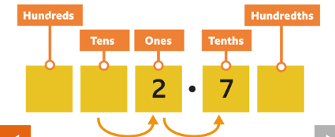
The digit in the tens column, moves to the ones and the digit in the ones column moves into the tenths column.
WALT: divide by 10 using decimals

Slide 8
WALT: divide by 10 using decimals

Slide 9
Remember, you can use the ladder or step resources to help you complete your work (these are saved in a separate document). Please let me know which task you have picked: ladder, step, main.
32 ÷ 10= 11. 24.7 ÷ 10=
49 ÷ 10= 12. 18.8 ÷ 10=
22 ÷ 10= 13. 783 ÷ 10=
83 ÷ 10= 14. 88 ÷ 10=
94 ÷ 10= 15. 1000 ÷ 10=
247 ÷ 10=
683 ÷ 10=
833 ÷ 10=
47 ÷ 10=
20 ÷ 10=
WALT: divide by 10 using decimals

Slide 10
Mastery:
270 ÷ 10= 27.0 Is this true or false? Explain your answer.
32 x 10= 3.2 Is this true or false? Explain your answer.
I have 39 sweets, I share it equally between four students. Each student will get 7 sweets. Is this correct? Why/ why not?
7899 ÷ 10=789.9 Is this true or false? How do you know?
Please make sure to show me how you worked each sum out.
WALT: divide by 10 using decimals

Slide 11
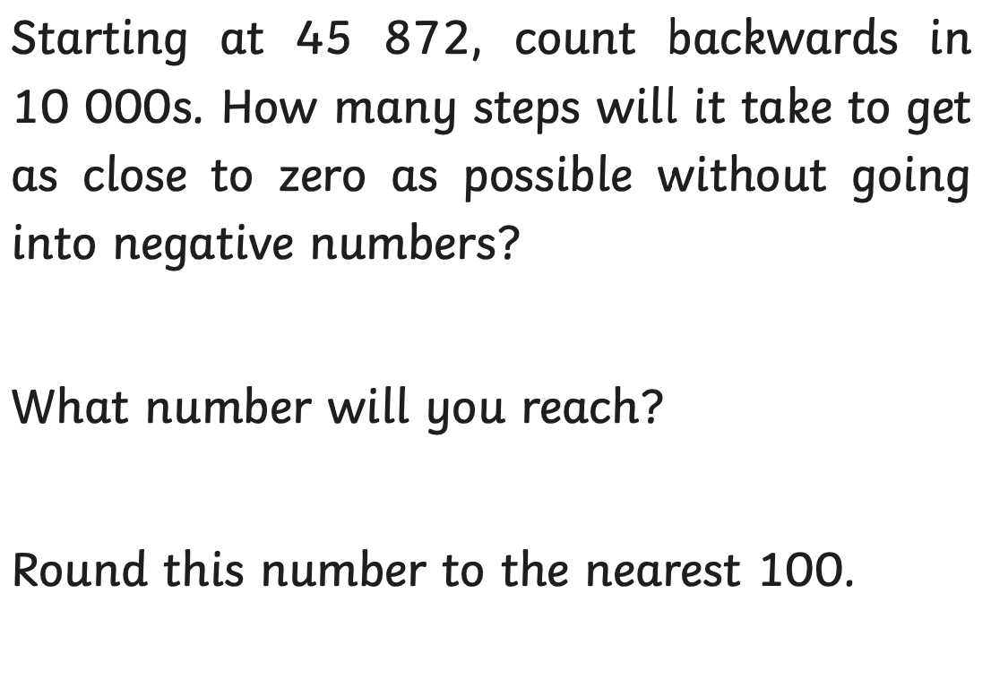
Math's mystery

