Slide 1
Can you make a word list for one of these sounds?
i-e | ie | igh

Slide 2
Wednesday 3nd February 2021
Today we will…
Read a list of words.
Spell words from the list.
finish reading the story and answer questions.
Write around the story.

Slide 3
from
such
smell
must
if
soft
hand
rock

Slide 4
Read the following questions and choose the correct ending.
Fox and the chicks went to the pond to get a drink/ go for a swim/ have a rest.
The duckchick said, “Run back to the pond/ the den/ Mama Hen.
Does this story remind you of another story?

Slide 5
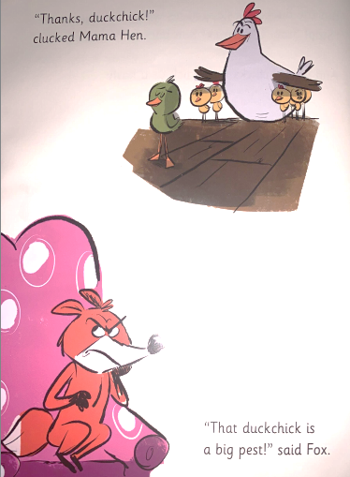
“Thanks, duckchick!”
clucked Mama Hen.
“That duckchick is a big pest!” said Fox.

Slide 6
Read the following questions and choose the correct ending.
Mama Hen was angry/ silly/ happy with the duckchick.
How did the Fox feel at the end?

Slide 7
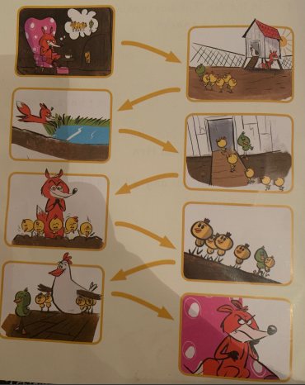
1
2
3
4
5
6
7
8

