Slide 1
Choose one sound from below and make a word list.
ow | a-e | oo
know

Slide 2
Tuesday 9th February 2021
Today we will…
Learn a new sound.
Practise reading and spelling words with the new sound.
Write sentences with new spellings, independently.

Slide 3
ai
Time to read..
Say the special friend sound
Fred the word
Say the word
road
moat
toad
goat
toast
road

Slide 4
zoad
soat
faich
baig
caw
nate
Time to read..
Say the special friend sound
Fred the word
Say the word
fowch
hobe

Slide 5
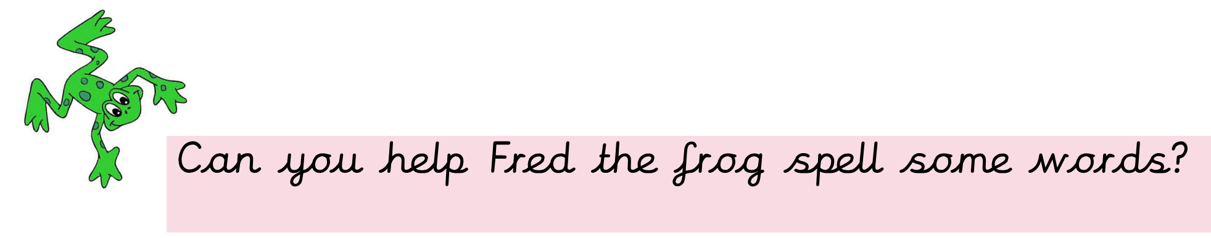
Fred is very impressed with your spellings!! He wants to know if you can write 2 sentences using two different words?

Slide 6
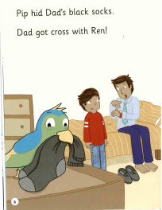

Slide 7
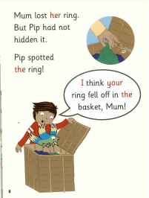
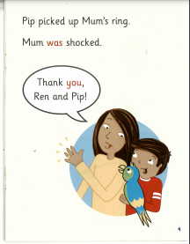

Slide 8
