Slide 1
Warm Up

Slide 2
WALT: write a new version of a myth
WILF: Planning paragraphs for the four main sections of my myth:
• Introduction to the characters • Problem to overcome • Journey undertaken • Resolution of the problem

Slide 3
Your story should still follow the narrative structure
Journey/quest to take
Power/special object
Leading to the problem
Mythical creature
Defeating mythical beast
Solving dilemma
Setting
Introduction to main characters and hero
Journey back, reward? Moral of the story?

Slide 4
Have a read through your story so far
Have you included sentence starters e.g. Despite her uncertainty, The blood-thirsty beast was, With a mighty swing…
Have you added fronted adverbials, expanded noun phrases and relative clauses?
Have you included descriptive vocabulary e.g. noble, brave, vicious, beautiful, tedious, etc
Have you included imagery i.e. similes, personification, show don’t tell….
How will your problem be resolved?
How will your story end?

Slide 5
Let's look at an example of a resolution
Despite Jasper’s efforts, his mighty sword was no longer mighty; instead, it was useless. As he gazed forward in desperation, he could see all the competitors charging ahead of him, leaving him behind pitifully. He squeezed his eyes so tightly that tears trickled down his face. He gave one wretched cry to lift his sword and tear through the thorns and vines in his path. At last! His path was clearing, and his sword was charged up with the power from his tears. Off he went, racing forward as he overtook his challengers one by one. Jasper could taste his victory as he neared the finish line, but not without one last obstacle; the final hurdle…

Slide 6
What sort of vocabulary could you use?
Fierce
Vicious
valiant
noble
Brave
doubtful
Triumphant
undefeated
Desperate
Powerful
Despair
distant
Victory

Slide 7
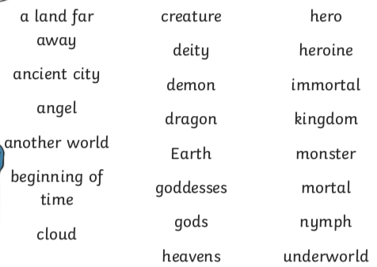
Key Words

