Slide 1
Can you make a list of words with the sound ‘i-e’

Slide 2
tion
attention
conversation
celebration
conversation

Slide 3
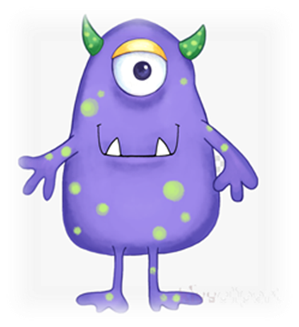
rire
zeart
fure
nubration
napture

Slide 4
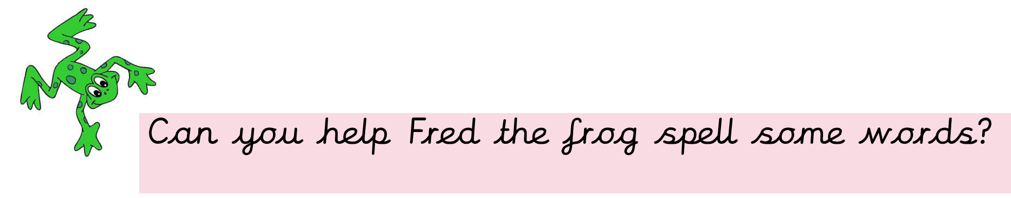
Fred is very impressed with your spellings!! He wants to know if you can write 2 sentences using two different words?

