Slide 1
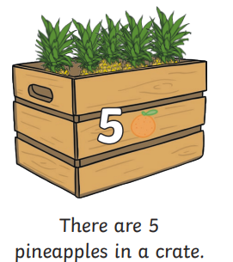
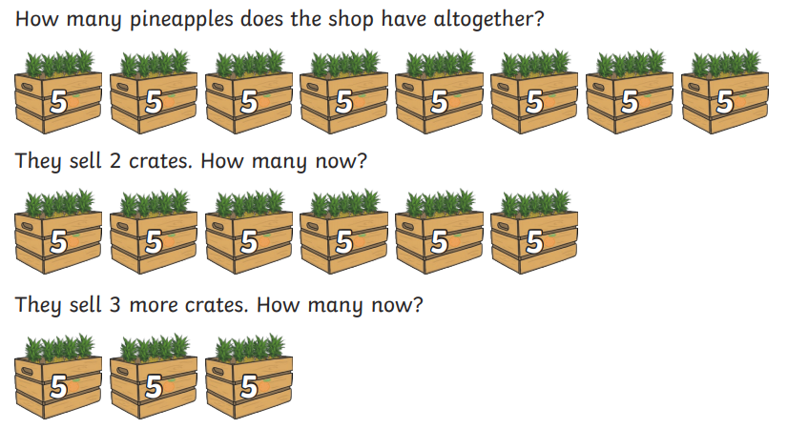
counting in 5s.

Slide 2
counting in 5s.

Slide 3
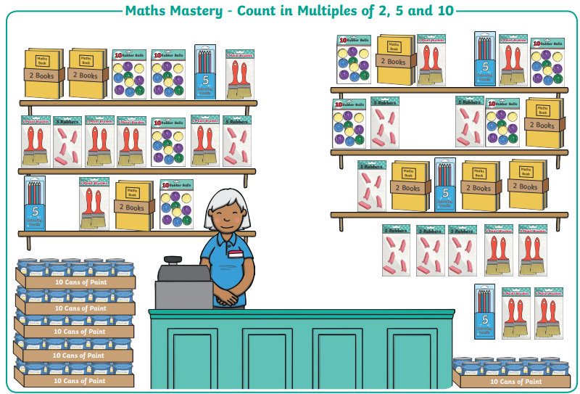
counting in 5s.
How many of these objects can you see in the shop?

Slide 4
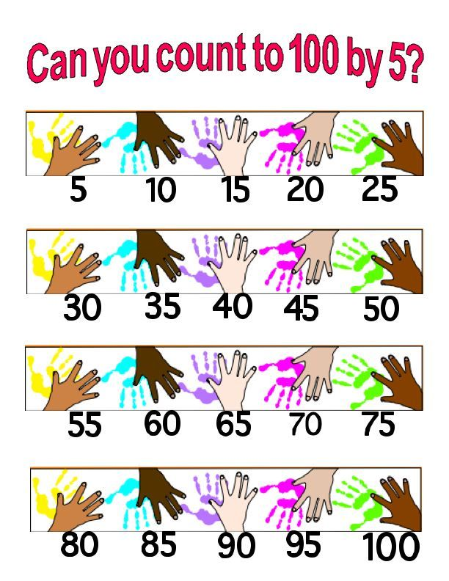
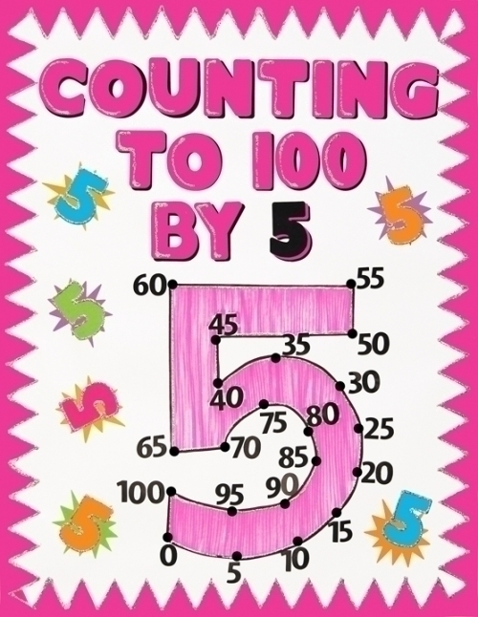
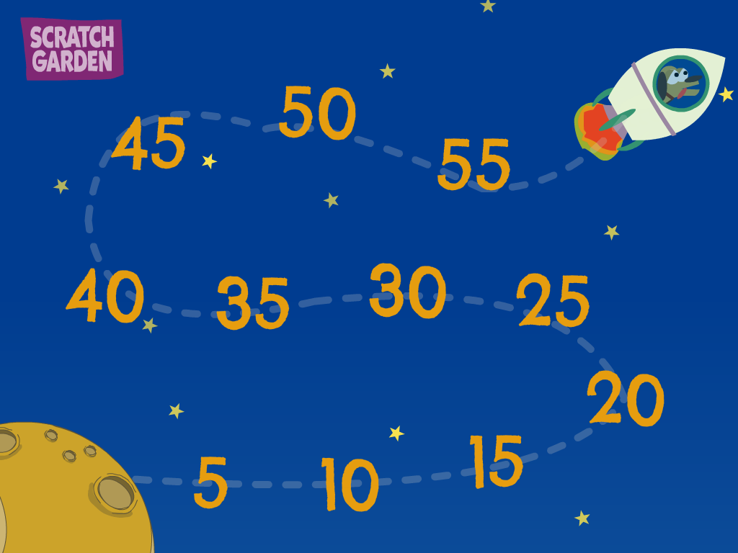
counting in 5s.
Now it’s your turn to make a counting in 5s poster.

