Slide 1
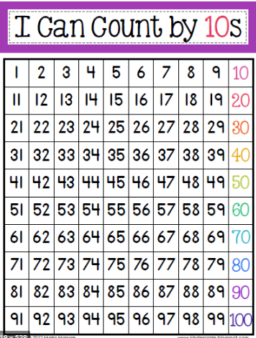
counting in 10s.
Let’s practice counting in 10s.
Can you say which digit stays the same? (tens or ones)
Can you say which digit changes every time? (tens or ones)

Slide 2
counting in 10s.

Slide 3
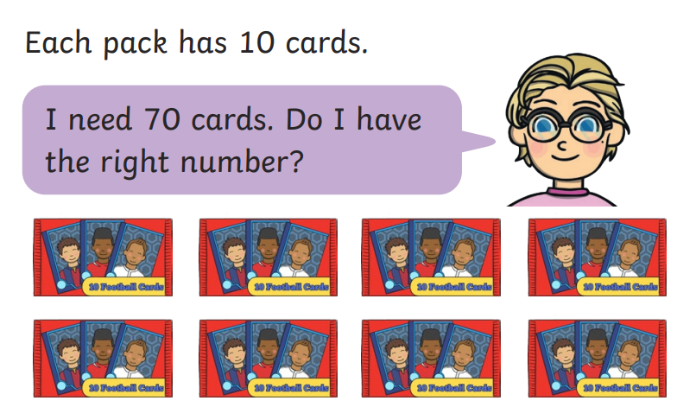
counting in 10s.

Slide 4
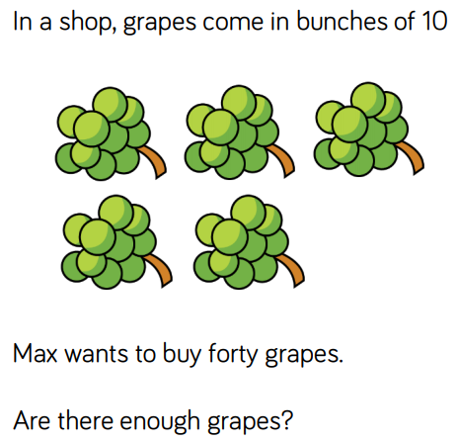
counting in 10s.
Whizz maths, it’s time to make a poster

Slide 5
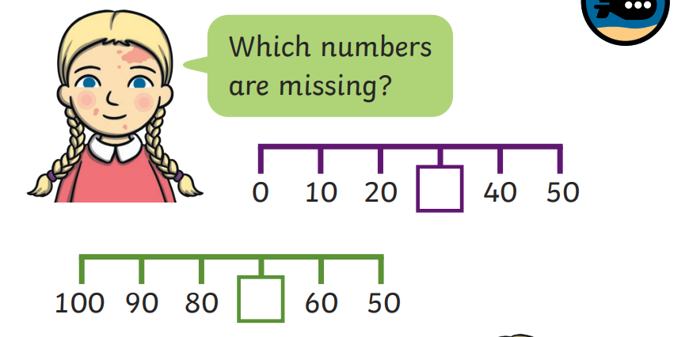
counting in 10s.

Slide 6
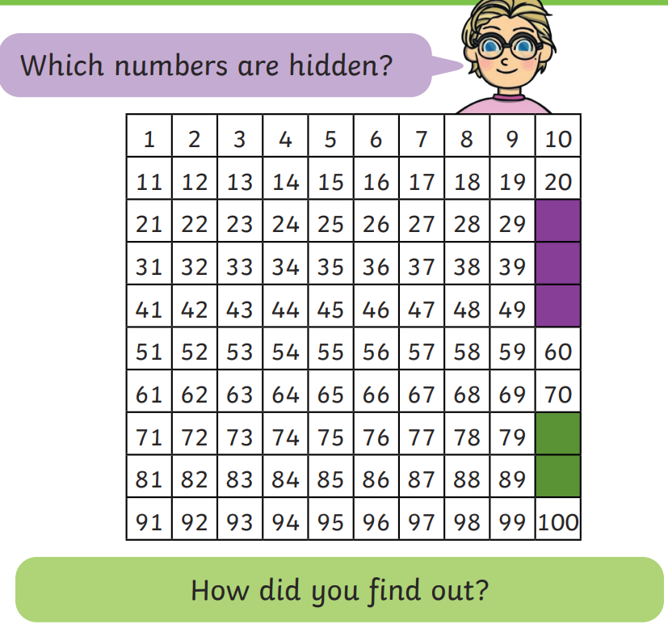
counting in 10s.
After this Bright Sparks, it’s time to make a poster…

