Slide 1
Maths
Measurement
Year One
Maths | Year 5 | Measurement | Converting Metric Measurements | Lesson 1 of 4: Wildlife Explorer

Slide 3
Aim
I can convert metric measures involving length.
Success Criteria
I can convert from millimetres to centimetres and vice versa.
I can convert from centimetres to metres and vice versa.
I can compare and order mixed metric measurements of length.

Slide 4
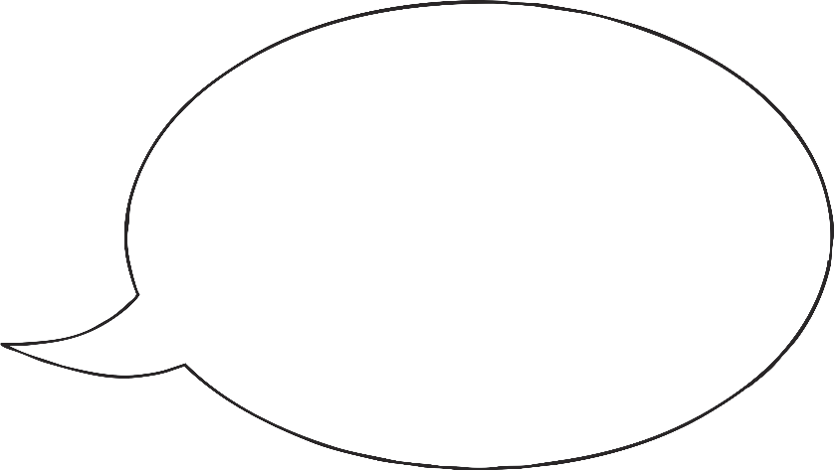
Nearest to Three Metres
In pairs, take turns to roll a dice three times. With each roll, decide whether to place the number you roll in the hundreds, tens or ones place.
Hundreds, Tens and Ones Place Value Grid
Hundreds | Tens | Ones
Last of all, I rolled another 2. I put that in the ones place.
My first number was a 5. I chose to put that in the ones place.
4
My first number was a 6. I chose to put that in the tens place.
2
5
Next, I rolled a 4. I put that in the hundreds.
Finally, I rolled a 2. I put that in the tens place.
The measurement I made was 425cm.
Next, I rolled a 2. I put that in the hundreds.
The measurement I made was 262cm.
2
6
2
The number you make is a measurement in centimetres. When both of you have made a three-digit number, the person whose number is closest to 3 metres scores a point.
Louise’s number was 125cm more than 3 metres. Sam’s number was 38cm less than 3 metres, so Sam would score a point.
Once you have chosen its position, you cannot change the place.

Slide 5
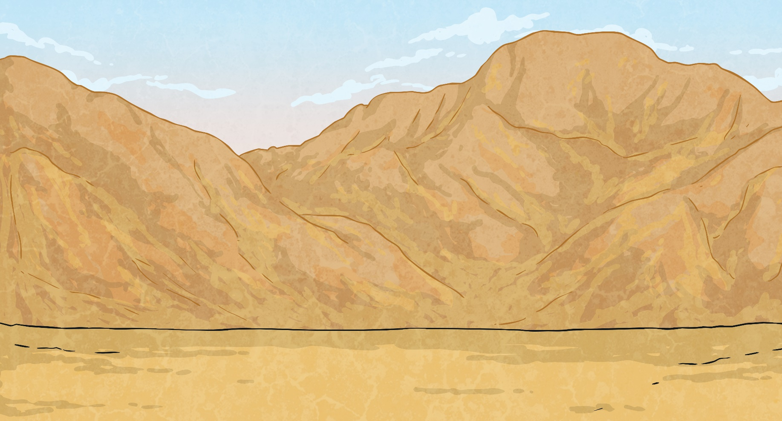
Spider Sizes
Sami is a wildlife explorer who has been collecting data about animals.
His first set of data is about spiders.

Slide 6
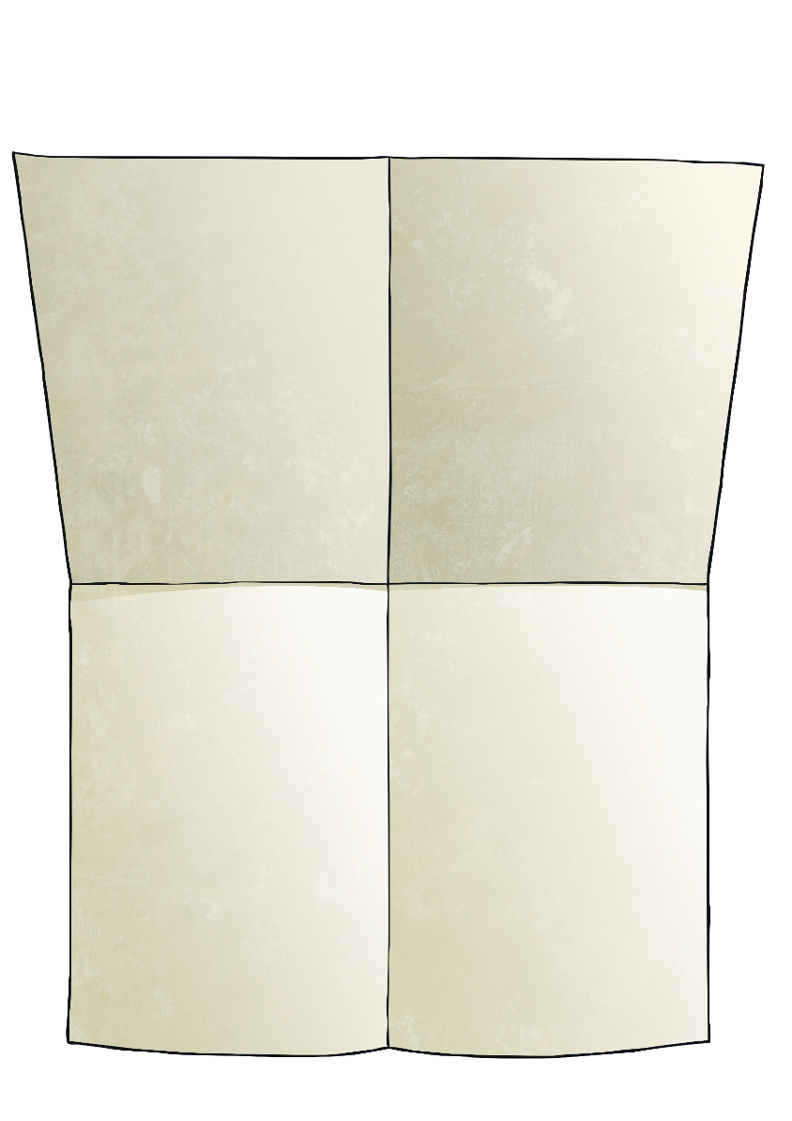
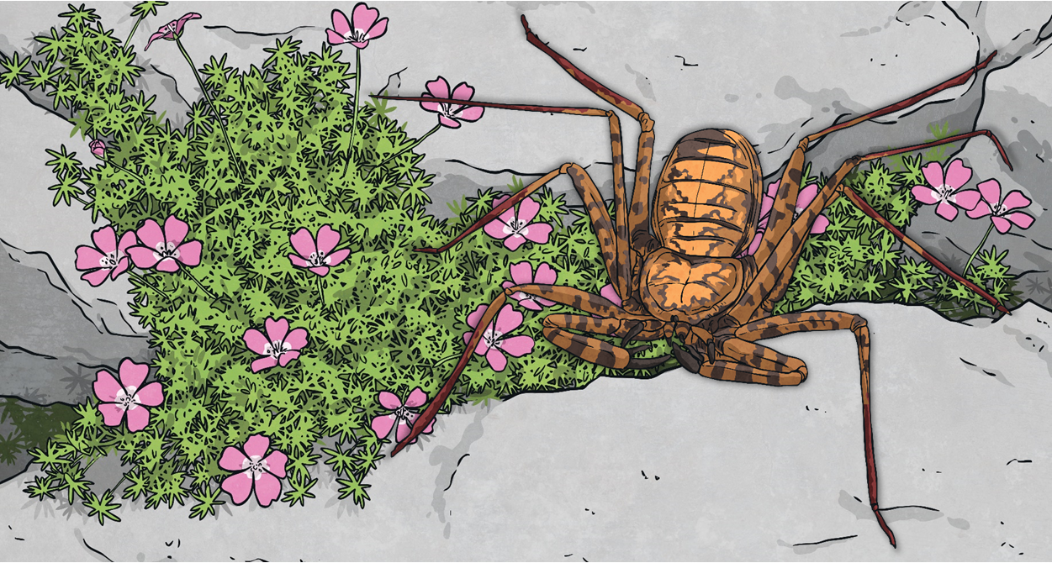
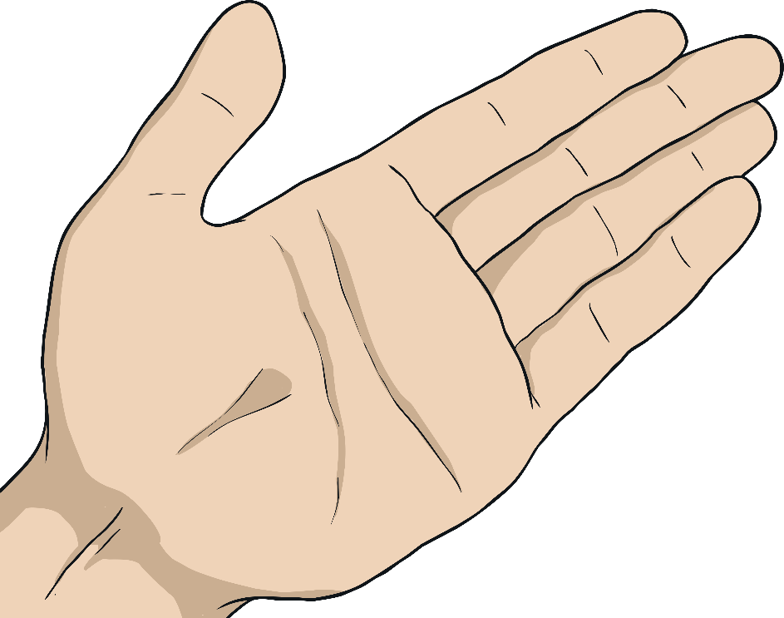
Spider Sizes
There are more than 40 000 different species of spider in the world. They are found in every continent except Antarctica.
Here are the average lengths of the bodies of some different species of spider:
Sydney funnel-web spider
3cm 5mm
wolf spider
3cm 4mm
cellar spider
2.5cm
king baboon spider
8cm 7mm
harvestman spider
9mm
trapdoor spider
2.8cm
orb-weaver spider
38mm
Goliath birdeater
11.9cm

Slide 7
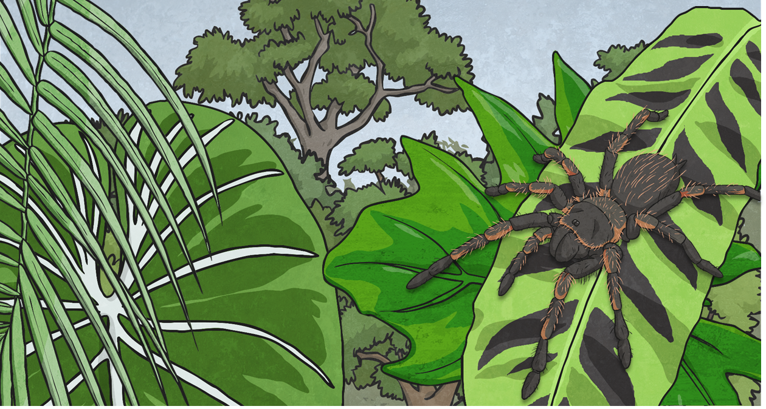
Spider Sizes
It is easier to compare measurements when they are all written in the same unit.
To do this, we could convert the measurements given in centimetres to millimetres.
How many millimetres are in one centimetre?
How do we convert centimetres to millimetres?
1cm = 10mm
We multiply by 10.
hundreds | tens | ones | tenths
To multiply by 10, each digit moves one place to the left:
8
7

Slide 8
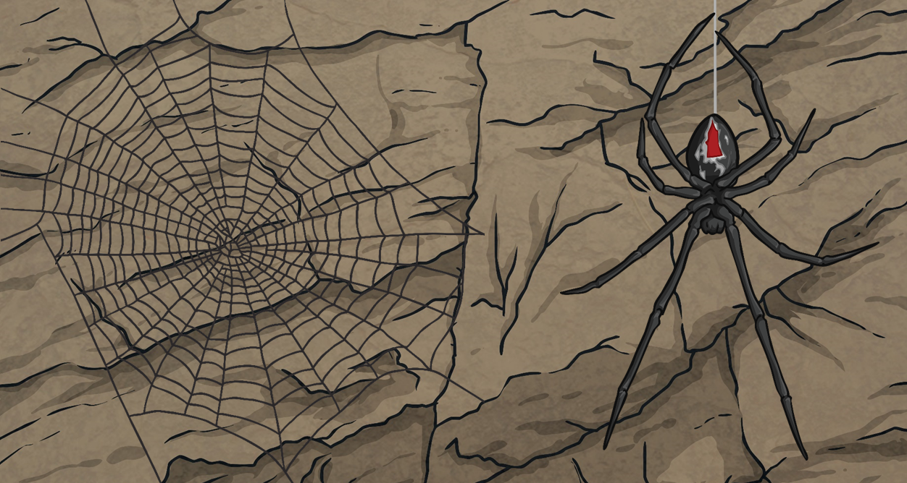
Spider Sizes
Convert these measurements from centimetres to millimetres.
Centimetres | Millimetres
Centimetres and Millimetres
There are 10mm in 1cm. So, for every 10mm in a measurement, you can count 1cm. For example, how many centimetres are there in 84mm?
Fill in the last column in the table.
6.8cm
68mm
6cm 8mm
5.1cm
51mm
5cm 1mm
4.2cm
42mm
4cm 2mm
8cm
What do we do with the 4mm that are left over? There aren’t enough to make a whole centimetre. We write them as millimetres on their own.
84mm = 8cm 4mm

Slide 9
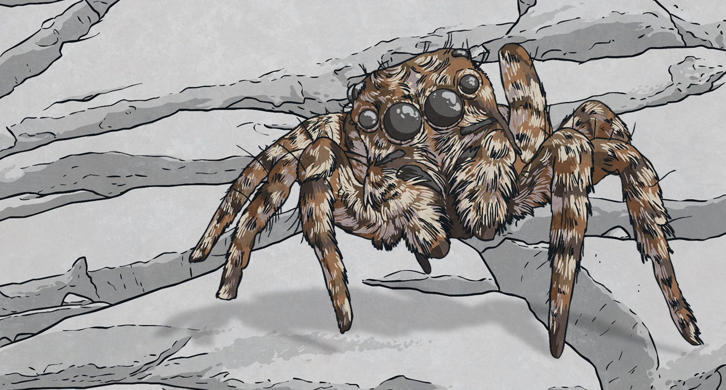
Spider Sizes
We could also convert the measurements that were given in millimetres into centimetres.
How many millimetres are in one centimetre?
How do we convert millimetres to centimetres?
1cm = 10mm
We divide by 10.
hundreds | tens | ones | tenths
To divide by 10, each digit moves one place to the right:
5
3

Slide 10
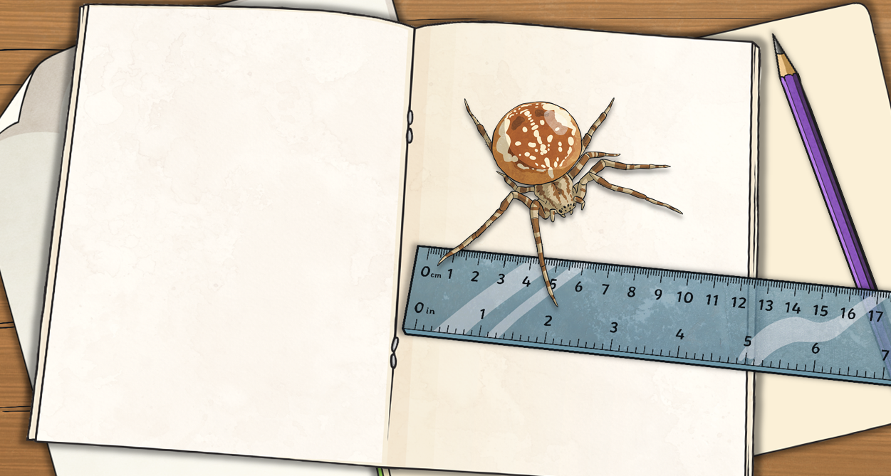
Spider Size Table
Use what you have learned to fill in the gaps in the Spider Size Table.
Average Body Lengths of Spiders
Spider | Centimetres | Millimetres | cm and mm
king baboon spider | 8.7cm | 87mm | 8cm 7mm
Sydney funnel-web spider |  |  | 3cm 5mm
trapdoor spider | 2.8cm
harvestman spider |  | 9mm
cellar spider | 2.5cm
wolf spider |  |  | 3cm 4mm
orb-weaver spider |  | 38mm
Goliath birdeater | 11.9cm
3.5cm
35mm
28mm
2cm 8mm
0.9cm
0cm 9mm
25mm
2cm 5mm
3.4cm
34mm
3.8cm
3cm 8mm
119mm
11cm 9mm

Slide 11
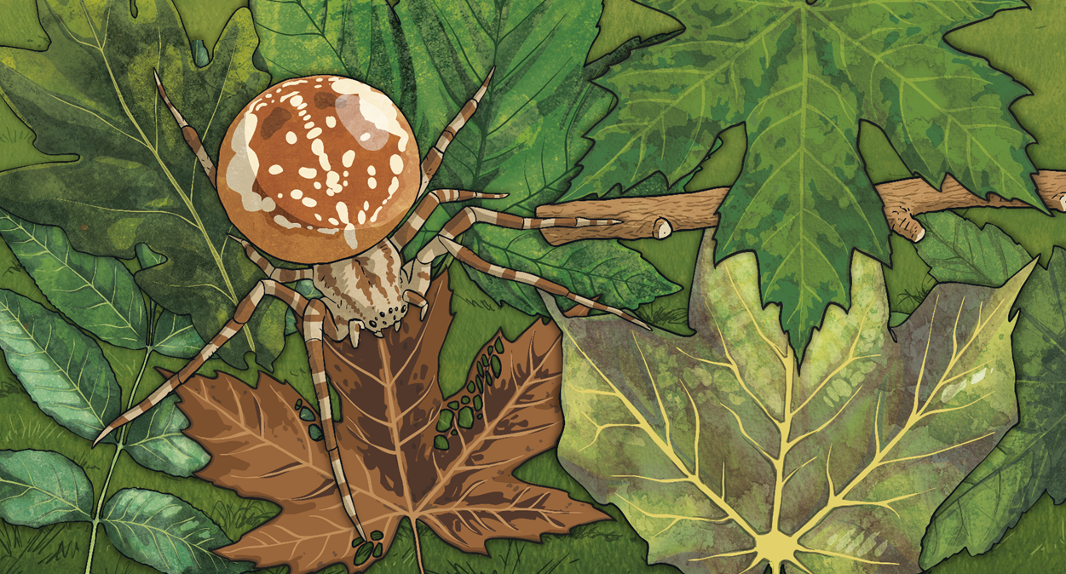
Spider Size Table
Compare the average body lengths of the spiders using < or >:
Table
Average Body Lengths of Spiders
Spider | Centimetres | Millimetres | cm and mm
king baboon spider | 8.7cm | 87mm | 8cm 7mm
Sydney funnel-web spider | 3.5cm | 35mm | 3cm 5mm
trapdoor spider | 2.8cm | 28mm | 2cm 8mm
harvestman spider | 0.9cm | 9mm | 0cm 9mm
cellar spider | 2.5cm | 25mm | 2cm 5mm
wolf spider | 3.4cm | 34mm | 3cm 4mm
orb-weaver spider | 3.8cm | 38mm | 3cm 8mm
Goliath birdeater | 11.9cm | 119mm | 11cm 9mm
Sydney funnel-web spider |  | orb-weaver spider
cellar spider |  | wolf spider
Goliath birdeater |  | Sydney funnel-web spider
<
<
>

Slide 12
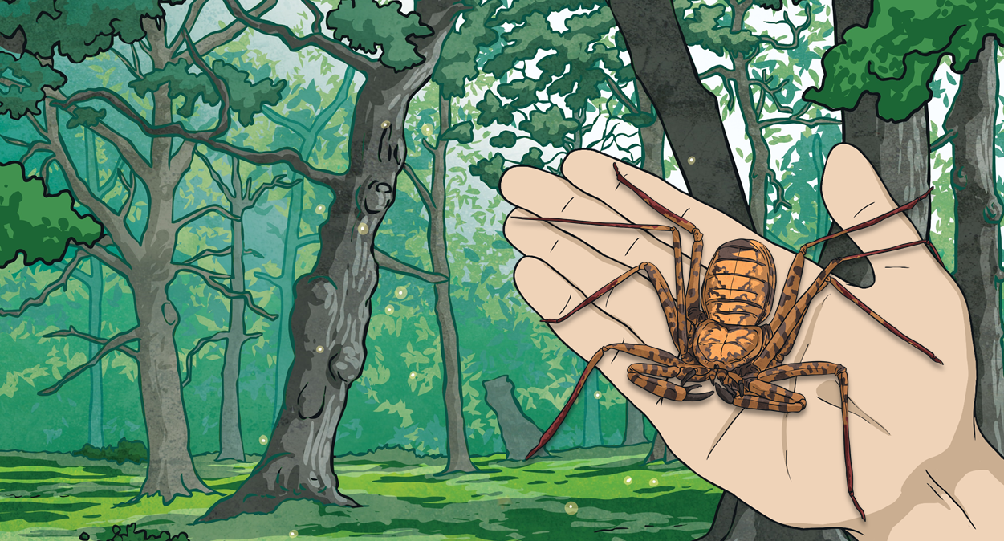
Spider Size Table
Order the spiders from shortest to longest:
Table
Average Body Lengths of Spiders
Spider | Centimetres | Millimetres | cm and mm
king baboon spider | 8.7cm | 87mm | 8cm 7mm
Sydney funnel-web spider | 3.5cm | 35mm | 3cm 5mm
trapdoor spider | 2.8cm | 28mm | 2cm 8mm
harvestman spider | 0.9cm | 9mm | 0cm 9mm
cellar spider | 2.5cm | 25mm | 2cm 5mm
wolf spider | 3.4cm | 34mm | 3cm 4mm
orb-weaver spider | 3.8cm | 38mm | 3cm 8mm
Goliath birdeater | 11.9cm | 119mm | 11cm 9mm
a) | b) | c) | d)
e) | f) | g) | h)
harvestman spider
cellar spider
trapdoor spider
wolf spider
Sydney funnel-web spider
orb-weaver spider
king baboon spider
Goliath birdeater

Slide 13
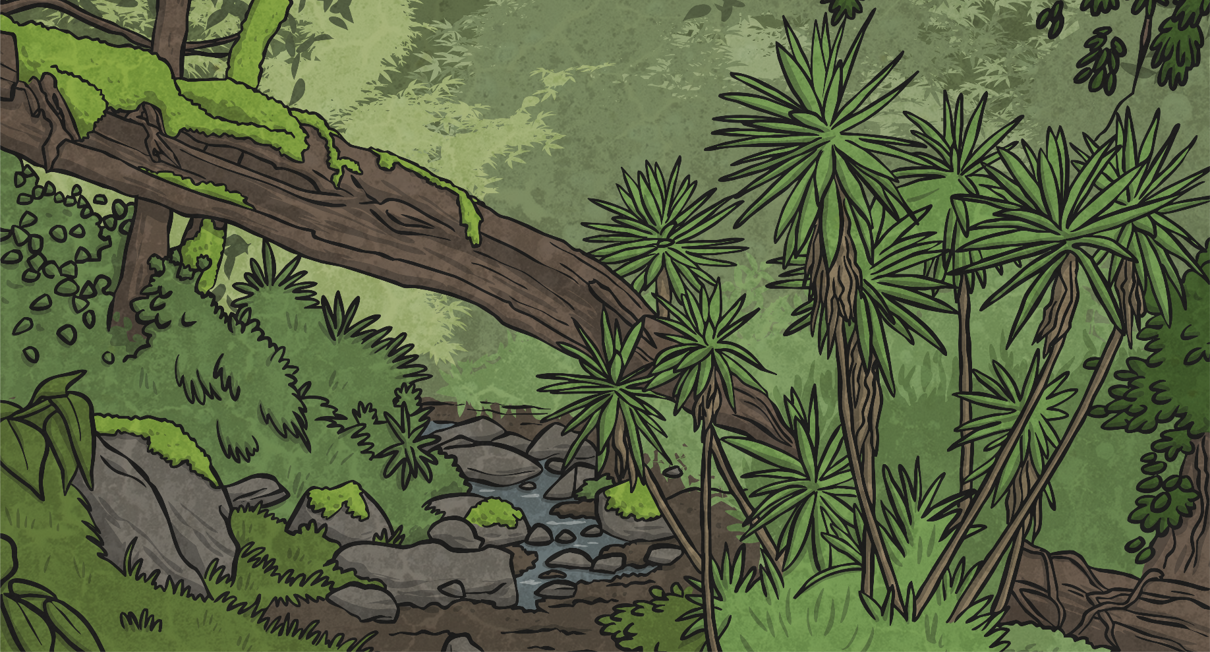
Snake Sizes
After he had completed his project on spiders, Sami decided to study snakes.
He collected data about some of the world’s shortest and longest snakes.

Slide 14
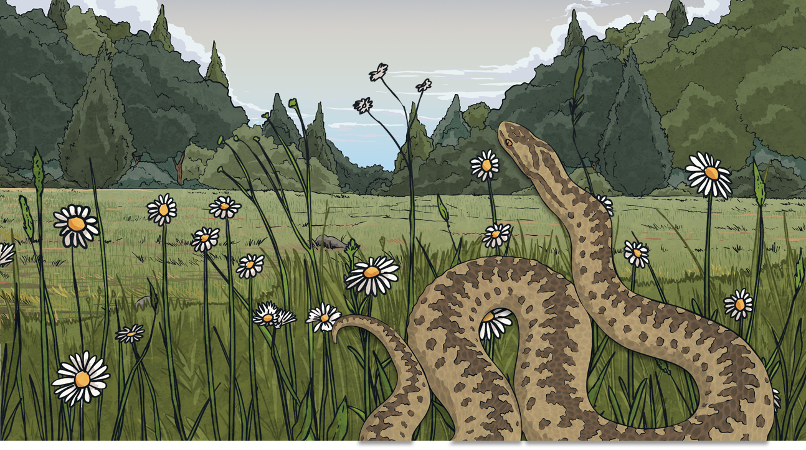
Snake Sizes
There are more than 3000 species of snake in the world. Here are the average lengths of some different snake species:
blind snake
32cm
boa constrictor
213cm
king cobra
4m 86cm
puff adder
115cm
giant anaconda
5m 21cm
black mamba
255cm
reticulated python
3.95m
rattlesnake
1m 85cm

Slide 15
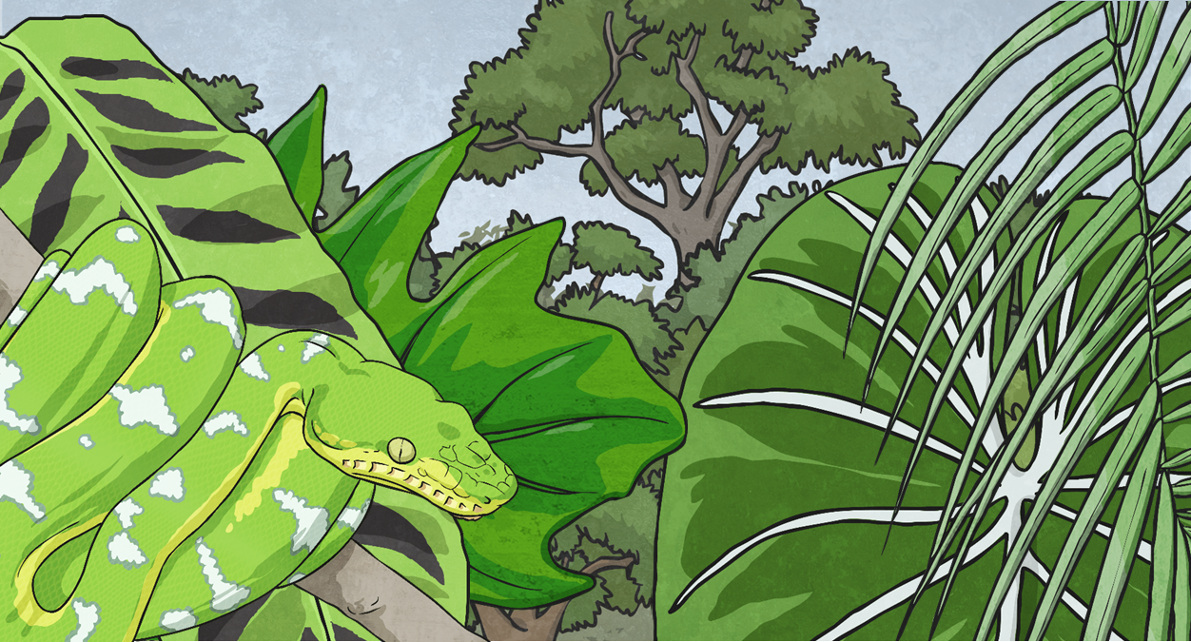
Snake Sizes
Remember, when comparing or ordering measurements, it is better to ensure that all measurements are written in the same unit.
How many centimetres are in one metre?
How do we convert metres to centimetres?
1m = 100cm
We multiply by 100.
hundreds | tens | ones | tenths
To multiply by 100, each digit moves two places to the left:
8
0
7

Slide 16
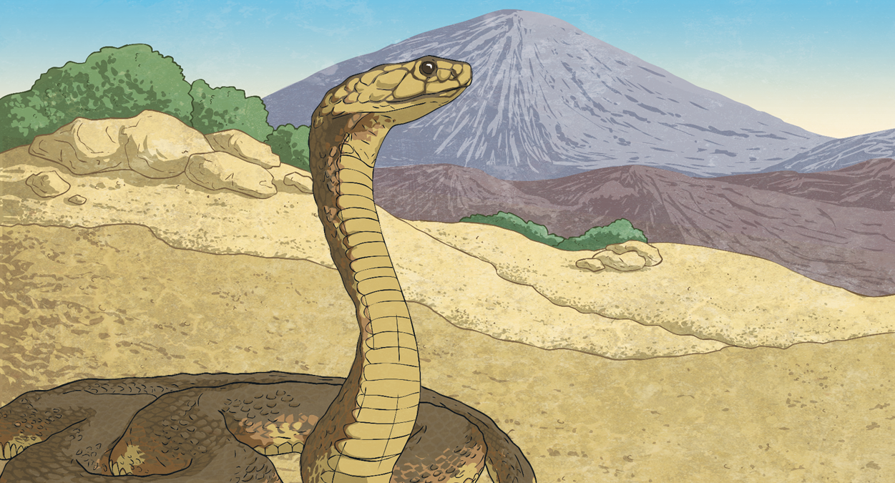
Snake Sizes
Convert these measurements from metres to centimetres.
Metres | Centimetres
Metres and Centimetres
There are 100cm in 1m. So, for every 100cm in a measurement, you can count 1m. For example, how many metres are there in 645cm?
Fill in the last column in the table.
2.32m
232cm
2m 32cm
5.59m
559cm
5m 59cm
4.85m
485cm
4m 85cm
6m
What do we do with the 45cm that are left over? There aren’t enough to make a whole metre. We write them as centimetres on their own.
645cm = 6m 45cm

Slide 17
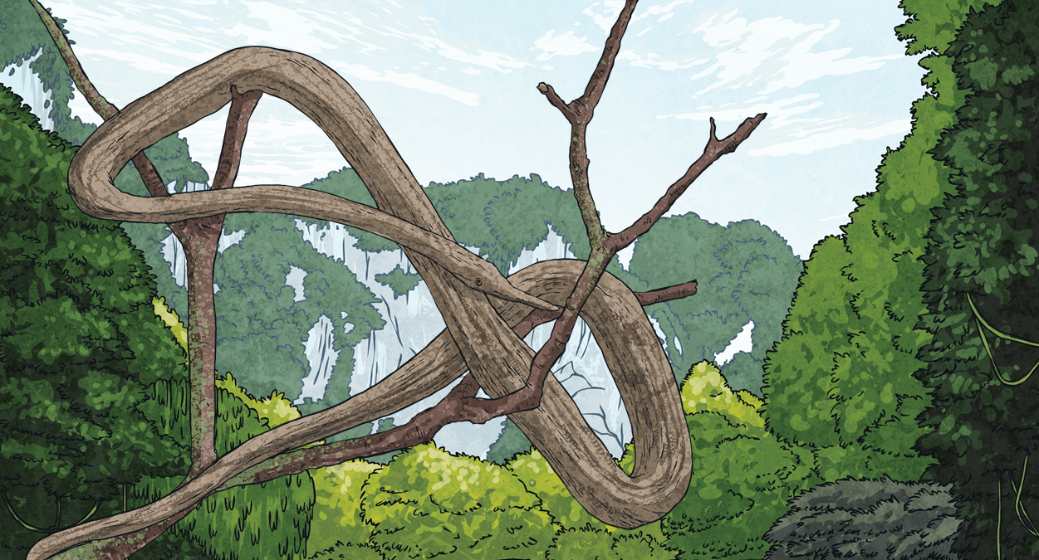
Snake Sizes
Remember, when comparing or ordering measurements, it is better to ensure that all measurements are written in the same unit.
How many centimetres are in one metre?
How do we convert centimetres to metres?
1m = 100cm
We divide by 100.
hundreds | tens | ones | tenths | hundredths
To divide by 100, each digit moves two places to the right:
3
5
1

Slide 18
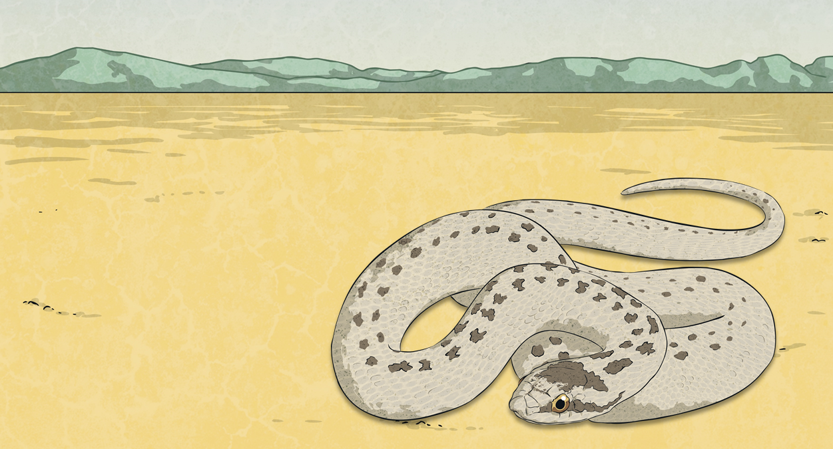
Snake Size Table
Use what you have learned to complete the Snake Size Table.
Average Lengths of Snakes
Snake | Metres | Centimetres | m and cm
giant anaconda | 5.21m | 521cm | 5m 21cm
puff adder |  |  | 1m 15cm
boa constrictor |  | 213cm
rattlesnake |  |  | 1m 85cm
black mamba |  | 255cm
king cobra |  |  | 4m 86cm
blind snake |  | 32cm
reticulated python | 3.95m
1.15m
115cm
2.13m
2m 13cm
1.85m
185cm
2.55m
2m 55cm
4.86m
486cm
0.32cm
0m 32cm
395cm
3m 95cm

Slide 19
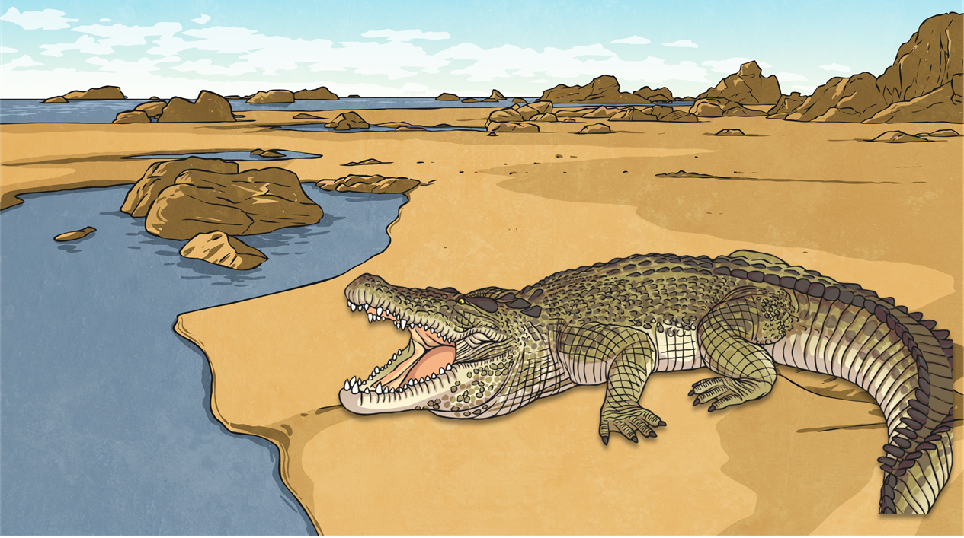
Snake Size Table
The average length of a Nile crocodile is 4.25m.
Table
Average Lengths of Snakes
Snake | Metres | Centimetres | m and cm
giant anaconda | 5.21m | 521cm | 5m 21cm
puff adder | 1.15m | 115cm | 1m 15cm
boa constrictor | 2.13m | 213cm | 2m 13cm
rattlesnake | 1.85m | 185cm | 1m 85cm
black mamba | 2.55m | 255cm | 2m 55cm
king cobra | 4.86m | 486cm | 4m 86cm
blind snake | 0.32m | 32cm | 0m 32cm
reticulated python | 3.95m | 395cm | 3m 95cm
Use your Snake Size Table to decide whether each snake is shorter than or longer than a Nile crocodile.
Shorter than a Nile crocodile | Longer than a Nile crocodile
blind snake
giant anaconda
reticulated python
king cobra
black mamba
rattlesnake
puff adder
boa constrictor

Slide 20
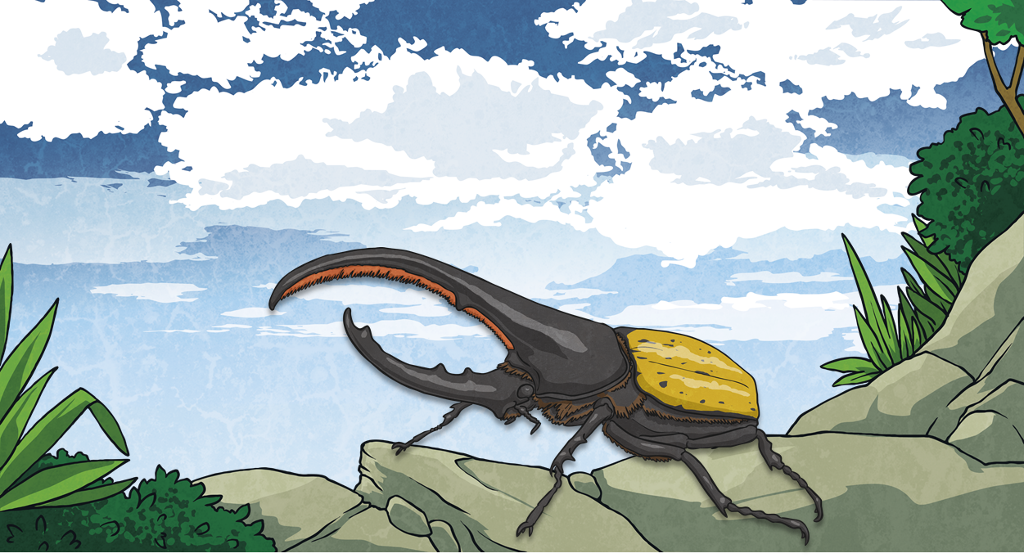
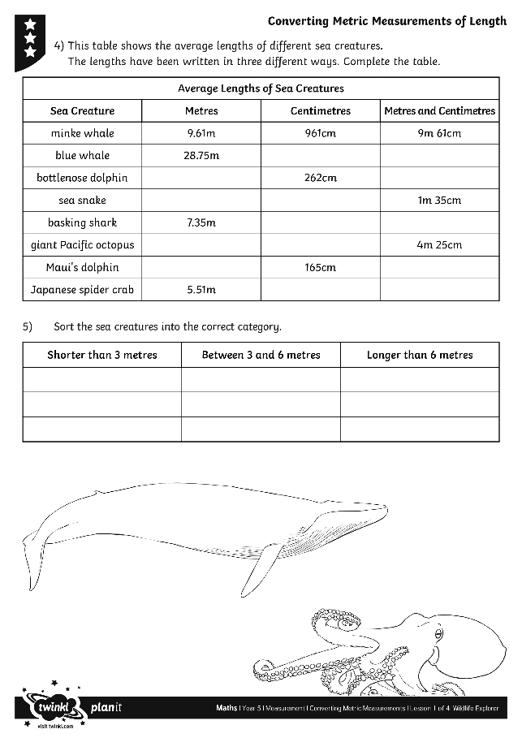
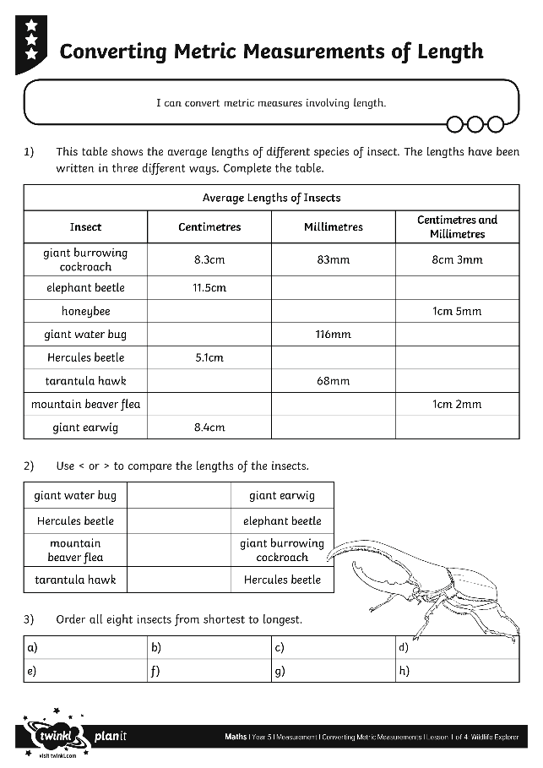
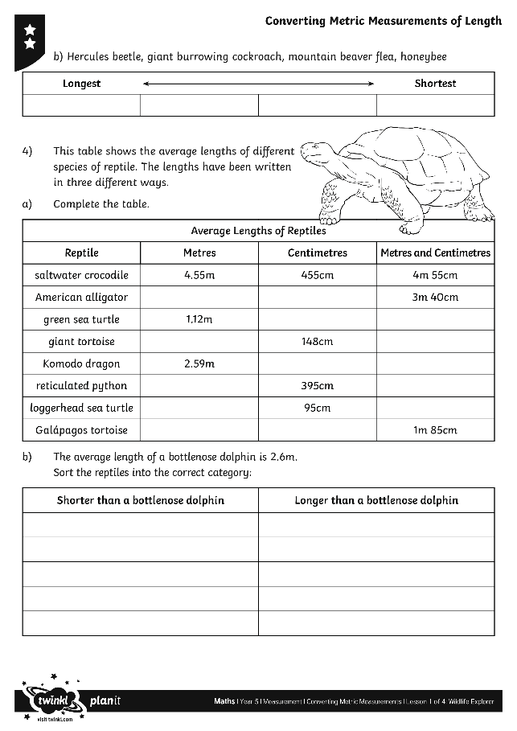
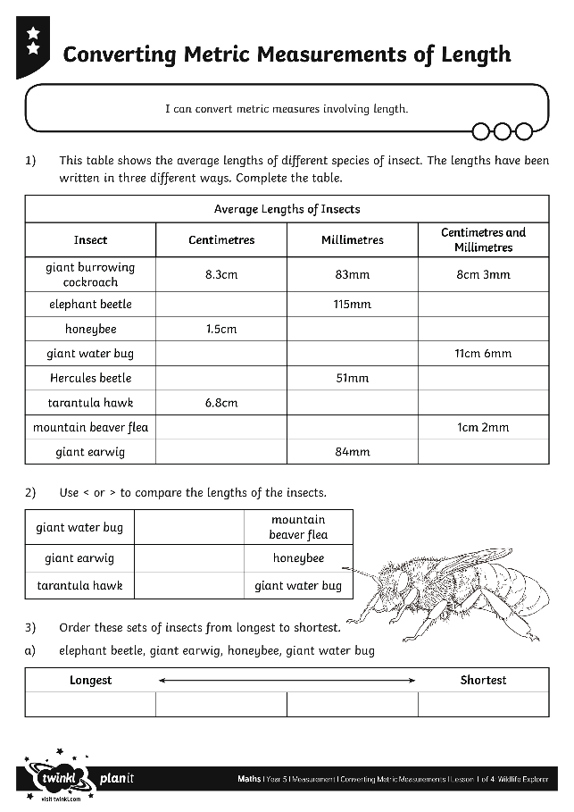
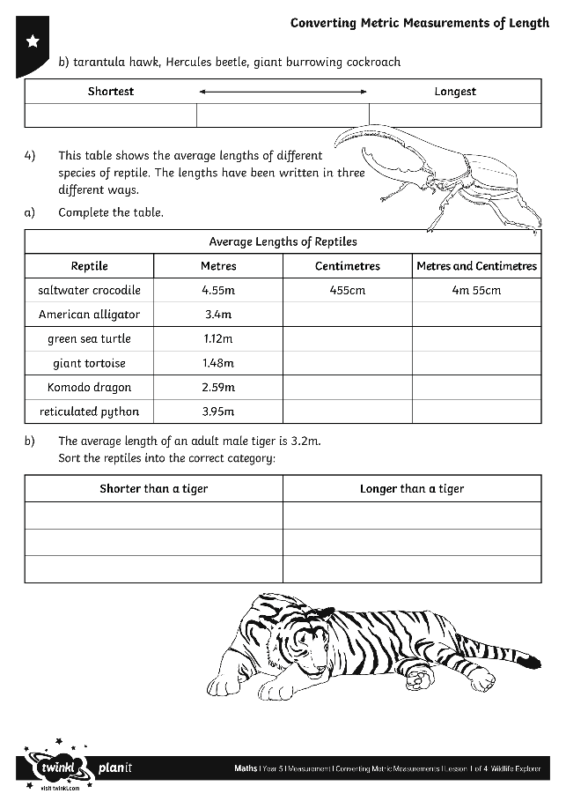
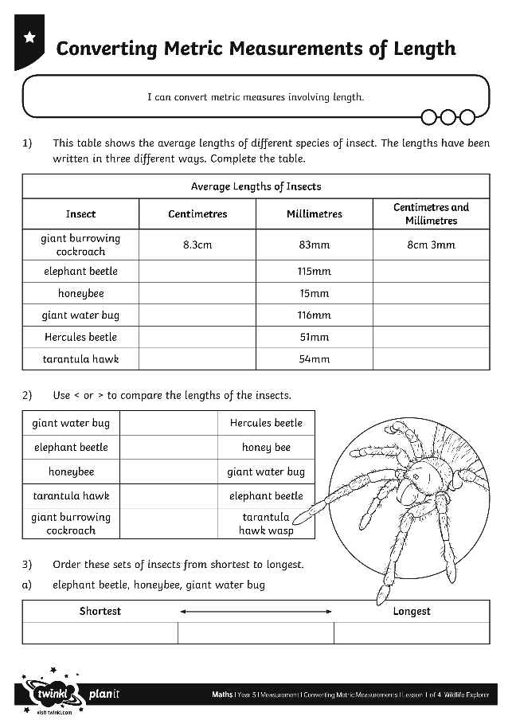
Converting Metric Measurements of Length
Use your marvellous measurement skills to complete these activity sheets.

Slide 21
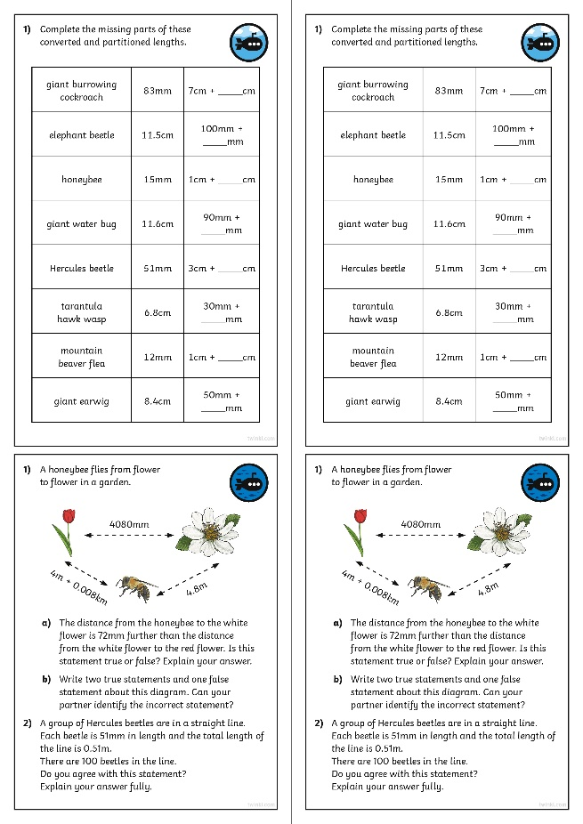
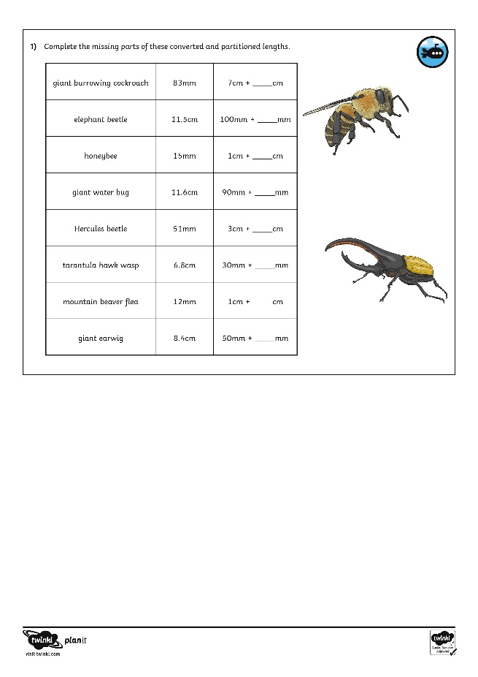
Diving into Mastery
Dive in by completing your own activity!

Slide 22
Spiders and Snakes
Here are the average lengths of some spiders and snakes. Order them from shortest to longest.
puff adder
115cm
blind snake
32cm
king baboon spider
8cm 7mm
reticulated python
3.95m
orb-weaver spider
38 mm
Goliath birdeater
11.9cm
shortest |  |  |  |  | longest

Slide 23
Aim
I can convert metric measures involving length.
Success Criteria
I can convert from millimetres to centimetres and vice versa.
I can convert from centimetres to metres and vice versa.
I can compare and order mixed metric measurements of length.

