Slide 1
Tuesday 2nd March 2021
Words to read | Make a list of words with the sound…
Miss Jay Ben Kim Beth Pip Sam Jess class tray clay okay dress dressing | aw

Slide 2
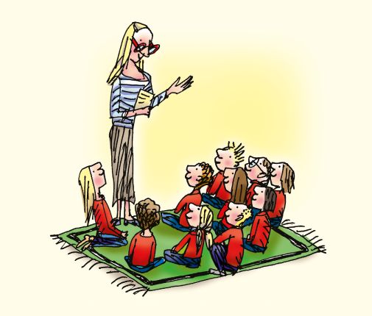
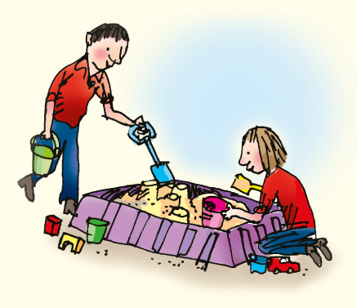
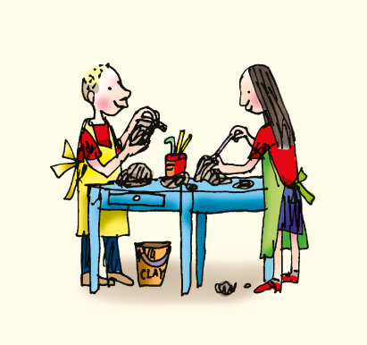
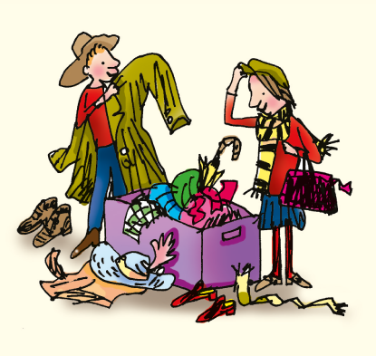
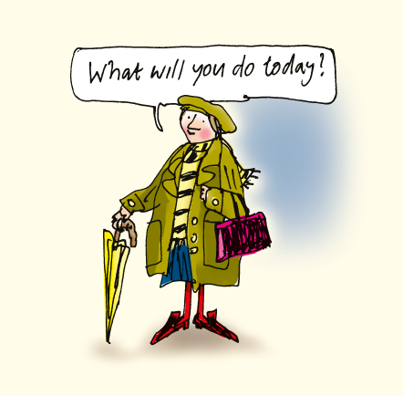
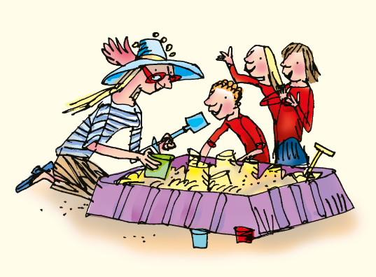
Tuesday 2nd March 2021

Slide 3
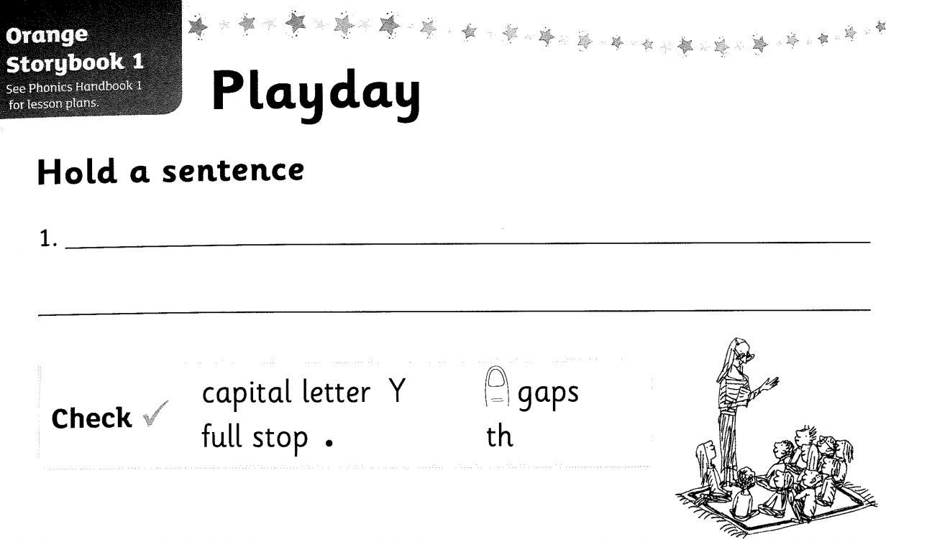
Tuesday 2nd March 2021
Red word:

Slide 4
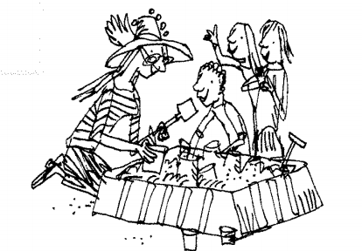
Tuesday 2nd March 2021

