Slide 1
Can you make a word list for one of these sounds?
air | are | ear
fair | care | dear

Slide 2
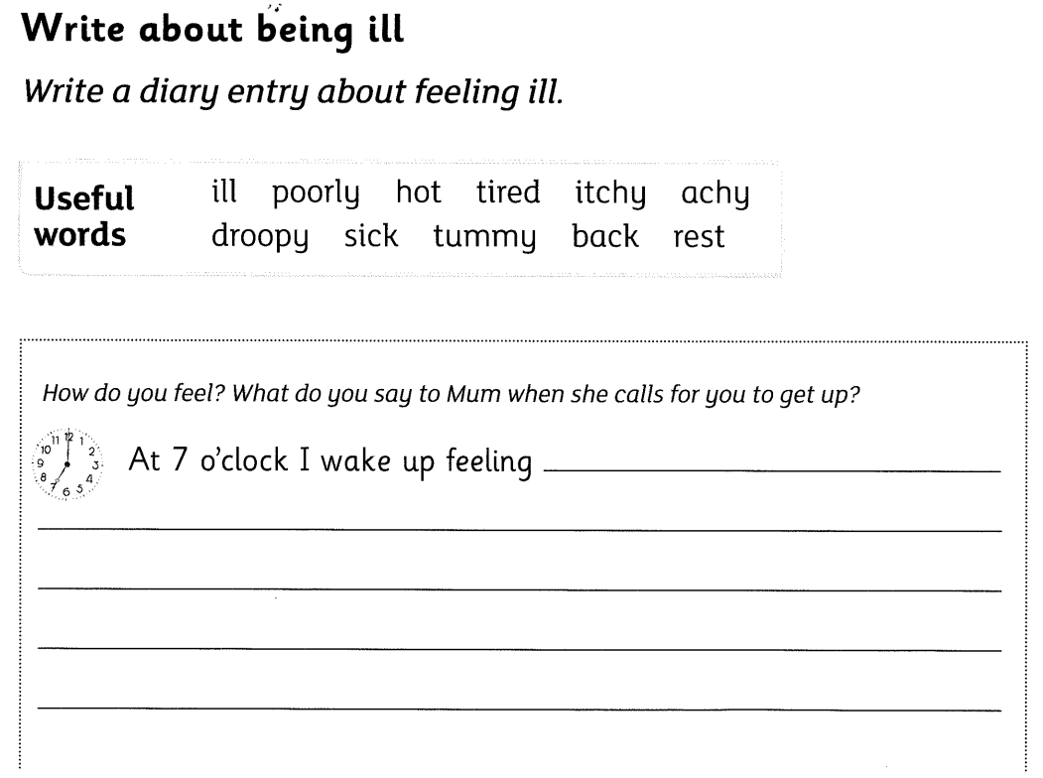
Wednesday 3rd March 2021
Tuesday 2nd March 2021
Monday 1st March 2021

Slide 3
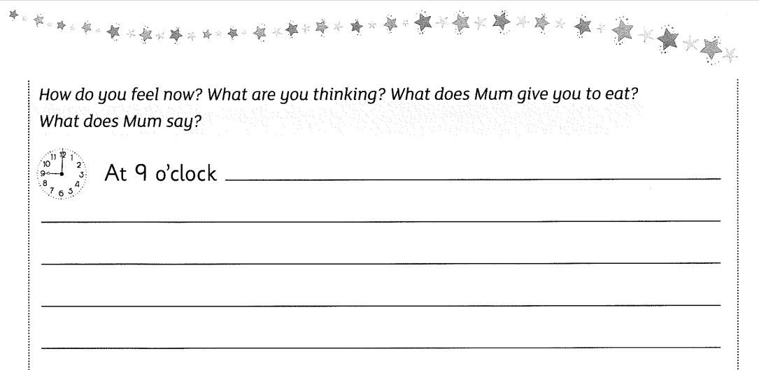
Wednesday 3rd March 2021
Tuesday 2nd March 2021
Monday 1st March 2021

Slide 4
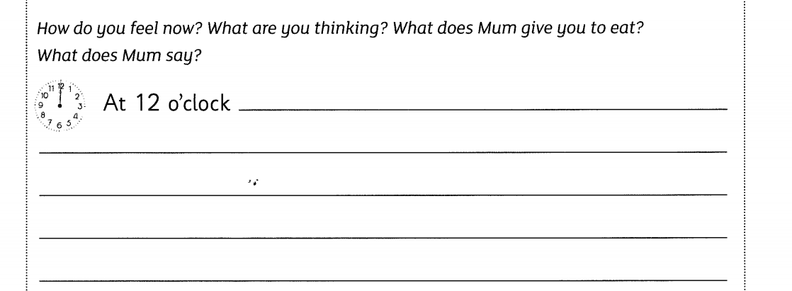
Wednesday 3rd March 2021
Tuesday 2nd March 2021
Monday 1st March 2021

Slide 5
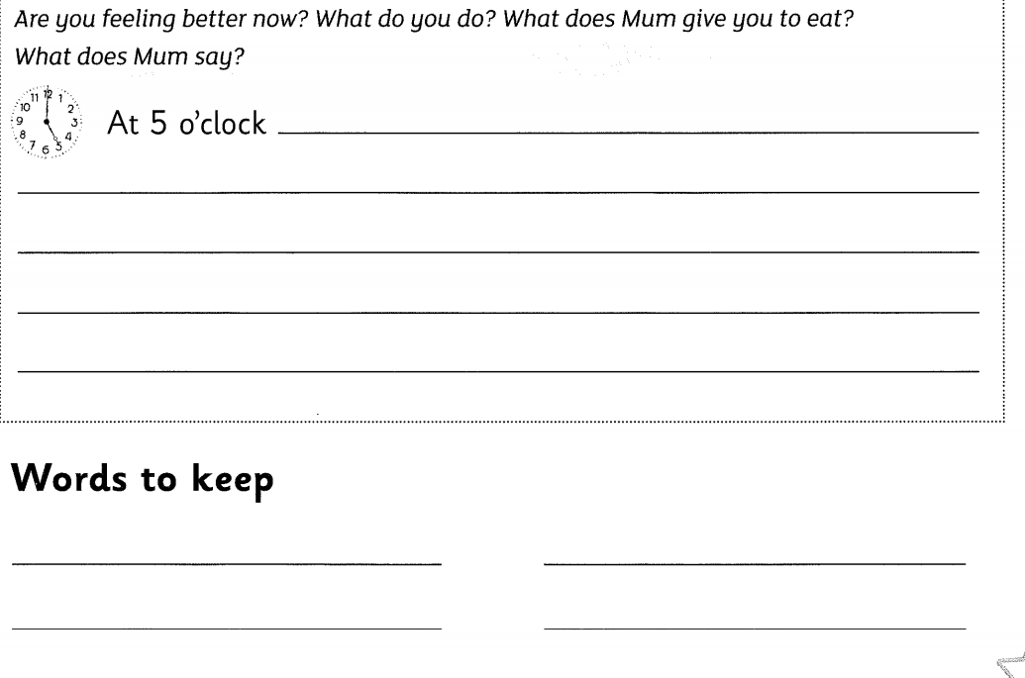
Wednesday 3rd March 2021
Tuesday 2nd March 2021
Monday 1st March 2021

