Slide 1
Wednesday 3.3.21
WALT: read and understand analog time

Slide 2
Warm up:
What is the difference between writing the time in the morning compared to the day time? Does anything change or does it stay the same…

Slide 3
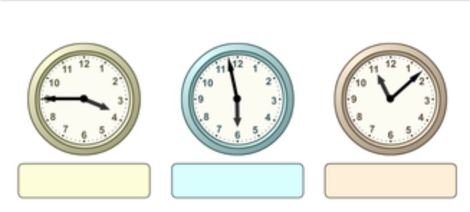
What is the time indicated on the analog clockface?
Write your answer in digital time…

Slide 4
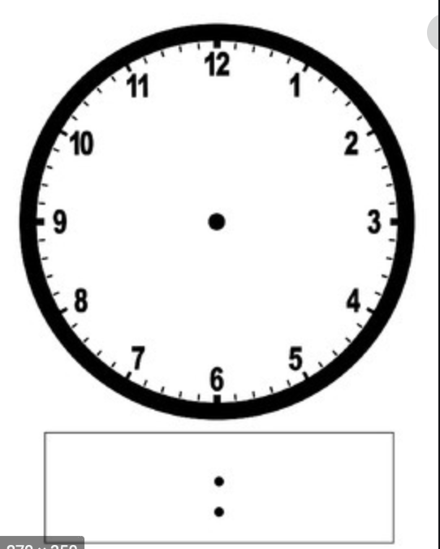
Copy the picture on the right into your books!!

Slide 5
On your analog clock face the time one twenty.
Once you have completed the clockface then complete the digital clock.
Finally, think and write down how you might say this time…? (verbally)

Slide 6
Repeat slide 4 and 5 with a different question..
E.g. two thirty = half past two = 2:30pm

Slide 7
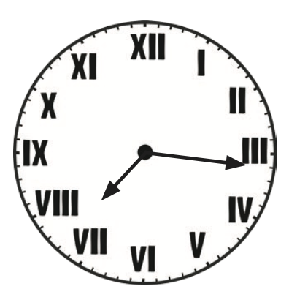
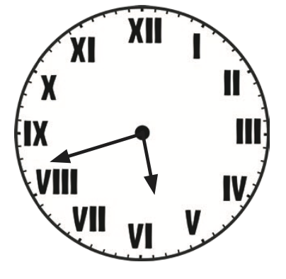
Extensions
1.
2.
Write the time in digital and 24hr time.

