Slide 1
Wednesday 3rd March 2021
Today we will…
Learn a new sound.
Practise reading and spelling words with the new sound.
Write sentences with new spellings, independently.

Slide 2
fair
air
Time to read..
Say the special friend sound
Fred the word
Say the word
stair
hair
chair
air

Slide 3
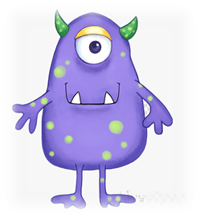
Time to read..
Say the special friend sound
Fred the word
Say the word
foo
gair
barp
forp

