Slide 1
Tuesday 2nd March 2021
Today we will…
Learn a new sound.
Practise reading and spelling words with the new sound.
Write sentences with new spellings, independently.

Slide 2
sort
or
Time to read..
Say the special friend sound
Fred the word
Say the word
short
fork
sport
horse

Slide 3
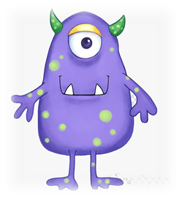
Time to read..
Say the special friend sound
Fred the word
Say the word
foo
jigh
barp
forp

