Slide 1
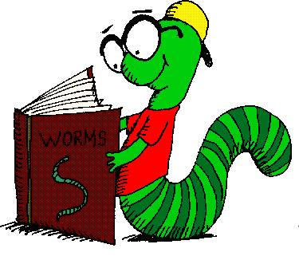
St. Cyprian’s Primary Academy The Road to Reading Key Stage 1
Rose Carr & Mary Meadway
November 2023

Slide 2
Aims
To have an understanding of:
The ‘balanced reader’
Decoding – Phonics
Decoding – sight vocabulary
Comprehension
Fluency and phrasing
Rhymes and poems to enable literacy

Slide 3
The twirup slikented loricantly noft the werfe. It vertered dwarnt the nipson veriforb. Jusnunctally, the twirup pooled an olky twend who was spooling round the borve. ‘Which Book and Why’ (eds.) Sue Bodman and Glenn Franklin
Activity 1:
Read this passage, aloud, together:

Slide 4
Answer these questions: The twirup slikented loricantly noft the werfe. It vertered dwarnt the nipson veriforb. Jusnunctally, the twirup pooled an olky twend who was spooling round the borve.
1. Where was the twirup slikening?
2. What sort of veriforb was it?
3. How would you describe the twend?

Slide 5
What skills did we use to answer those questions?

Slide 6
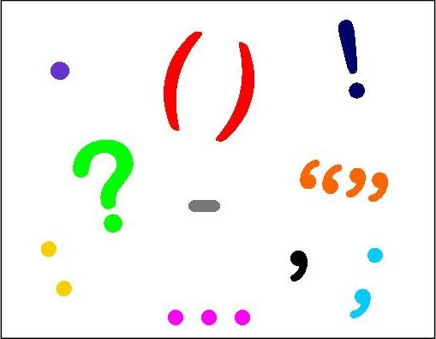
We used our knowledge of:
Phonics
Word structure
Sight Vocabulary
Punctuation
Sentence Structure/Syntax

Slide 7
What skills didn’t we use?

Slide 8
We didn’t use:
Expression and phrasing
Comprehension/word meanings
Links to knowledge of the world

Slide 9
‘The balanced reader’ The PM Story (Cengage PM Materials)
Levelled Text
Fluency
and
Phrasing
Decoding
Comprehension 1.Literal
2.Inference
3.Response
Wide Range of Text Types or Genres

Slide 10
What is Decoding?
Think about the skills you used to decode this text?

Slide 11
What is phonics?
The learner will:
recognise the sounds that letter makes
identify the sounds that different groups of letters make such as ‘ch’ or ‘ai’
blend these sounds together to make a word
This is one of the skills which will help the learner ‘decode’ new words that they hear or see. It is an essential step in learning to read.
There are 44 common sounds in the English language.

Slide 12
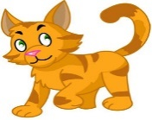
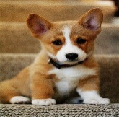
Sound | Common Spelling | Common Spelling Alternatives
/b/ | b ball
/c/ | C cat |  | k kite | ck back
/d/ | d dog |  | dd add
/f/ | f fan |  | ff cliff | ph phone
/g/ | g grapes |  | gg egg
/h/ | h hat |  | wh who
/j/ | j jellyfish |  | g giraffe | gg exaggerate
Consonants

Slide 13
Can you use phonics only to read these words?
Activity 2:
was
ask
you
where
some
because
what
the
come
were
there
their
said
who

Slide 14
These words a child needs to know on sight and are known as the sight vocabulary.
These are words learner cannot decode simply by using their phonological awareness
These high frequency words must be recognised automatically
They are also known as ‘tricky words’ (A school must decide on a common terminology e.g. ‘sight’ words, ‘tricky words’)
For learners to make steady progress in reading they must build their sight vocabulary bank constantly and continually

Slide 15
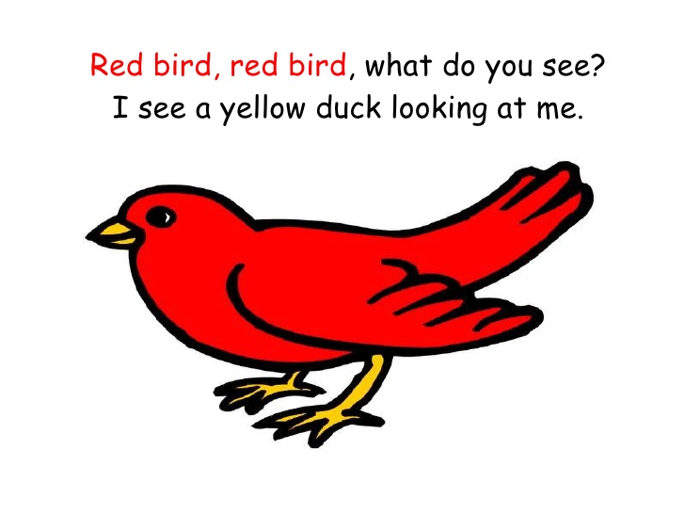
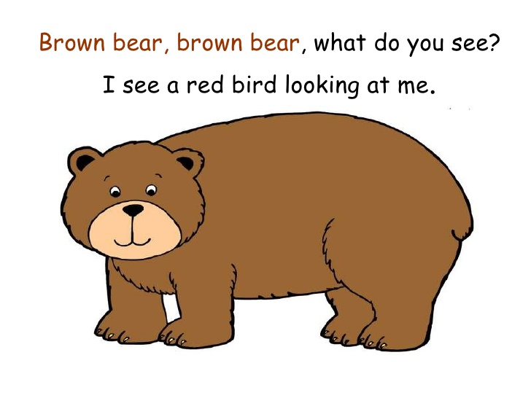
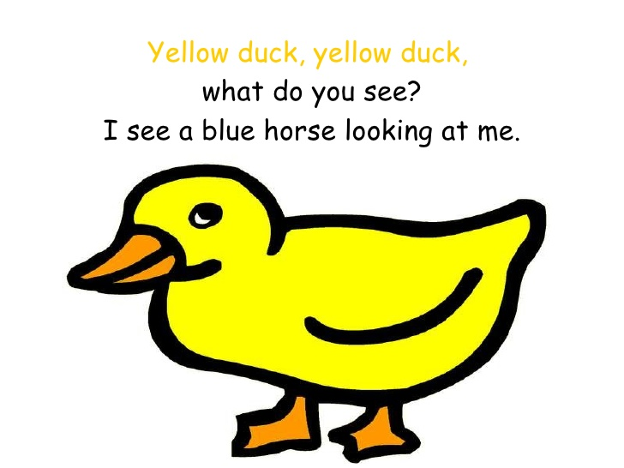
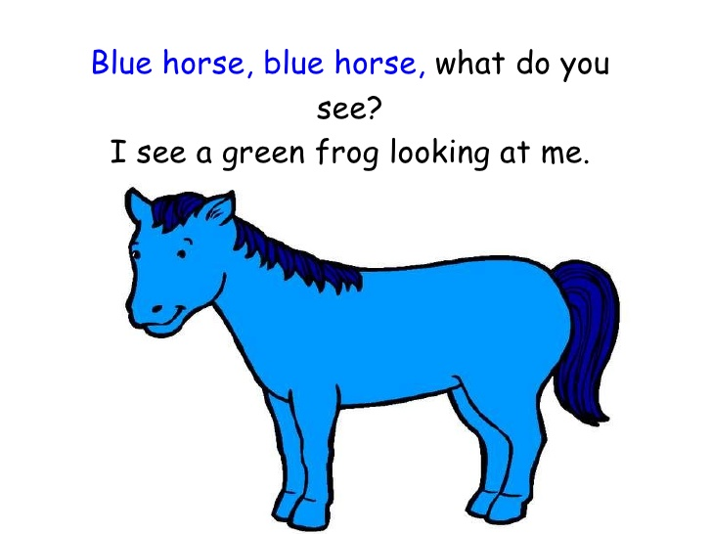
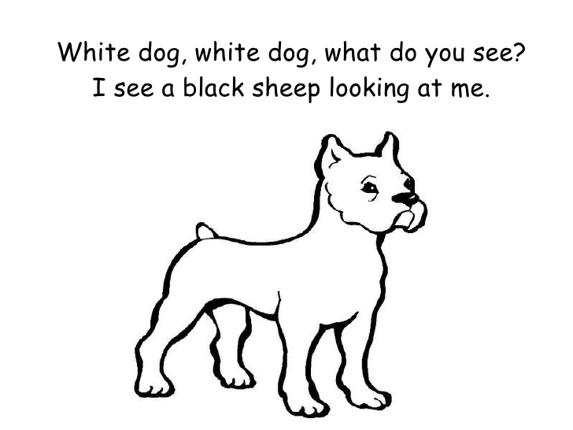
Brown Bear, Brown Bear, What Do You See?

Slide 16
‘The balanced reader’ The PM Story (Cengage PM Materials)
Levelled Text
Fluency
and
Phrasing
Decoding
Comprehension & retelling 1.Literal 2.Inference 3.Response
Wide Range of Text Types or Genres

Slide 17
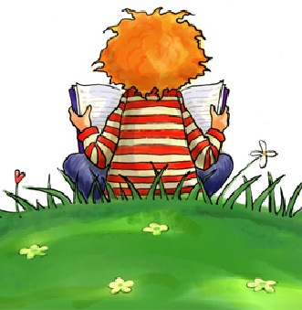
To produce a balanced reader a school requires:
Explicit and systematic assessment which will inform
The explicit and systematic teaching of reading.

Slide 18
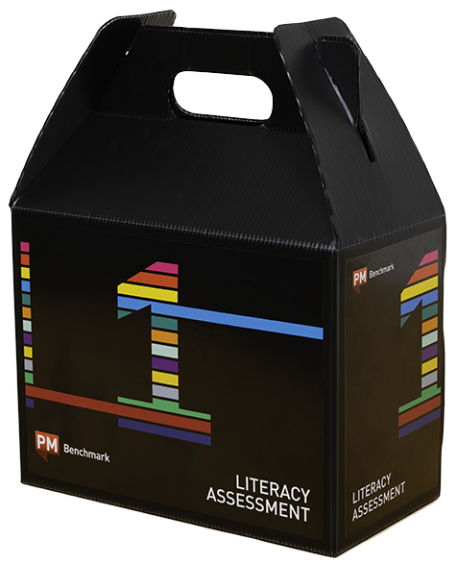
St Cyprian’s is providing the explicit and systematic assessment through benchmarking your children.

Slide 19
To develop ‘The Balanced Reader’ we need:
The right book
In the hands of the right child
At the right time
How does a teacher make this happen?

Slide 20
A benchmark reading record gives the following information
It gives:
The accuracy rate on the levelled text
The level of competency in retelling and comprehension
The level of competency in fluency and phrasing
Specific information on reading skills and behaviours to inform planning and teaching

Slide 21
Progression of successful text reading
through the Book Bands
Book Band | Reading Level | Reading Stages
Magenta | 1 – 2 | Emergent Early
Red | 3 – 5
Yellow. | 6 – 8
Blue | 9 – 11
Green | 12 – 14
Orange | 15 – 16 | Developing
Turquoise | 17 – 18
. Purple | 19 – 20
Gold | 21 – 22 | Consolidating
White (Silver) | 23 – 24
Lime (Emerald) | 25 | Extending
Lime (Emerald) | 26
Ruby | 27
Ruby | 28
Sapphire | 29
Sapphire | 30

Slide 22
Retelling and comprehension
It is paramount that a child is reading for meaning and understanding.
A child can be reading at 100% accuracy but not able to retell the story or answer the questions to a satisfactory level.
If retelling or comprehension is poor, children need to drop to a level where it is satisfactory however easy the text is.

Slide 23
Comprehension When reading with your child you should encourage this vital part of reading
What is comprehension?
Comprehension is the ability to understand what you have read
Comprehension strategies should be taught from the beginning stage of reading
The three components of comprehension are literal, inferential and response/applied knowledge

Slide 24
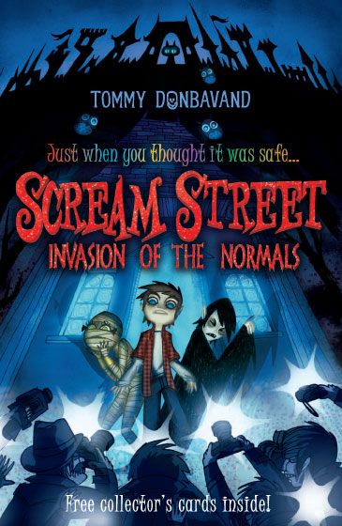
LITERAL QUESTIONS
RIGHT THERE
IN THE TEXT
ON THE LINES

Slide 25
Developing comprehension through literal questioning
Literal Questions
What….?
Where….?
Who….?
How….?
When…?
The learner will find the answer directly in the book.

Slide 26
INFERENTIAL QUESTIONS
THINK AND SEARCH
LOOK FOR CLUES
BETWEEN THE LINES

Slide 27
Developing comprehension through inferential questioning
The child will find the answer by searching several places in the book.
Compare and contrast e.g. Characters in the book.
Cause and effect e.g. What factors caused an event to happen?
Main idea e.g. What are some examples of…?

Slide 28
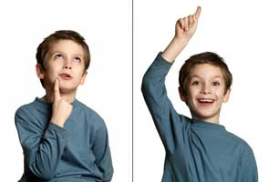
RESPONSE QUESTIONS
ON MY OWN
MY IDEAS
BEYOND THE LINES !

Slide 29
Developing comprehension through response/applied knowledge
The learner will think about what they have read and draw on and make connections with prior knowledge and emotions.
Why do you think..?
What would have happened if…?
Do you think it was right for..?
Why would..?
What if…?

Slide 30
Comprehension - Retelling
Retelling is another way to check comprehension
Ask the learner to read a book and then ask them to tell you as much as they can about the story.
It is important not to give any prompts.

Slide 31
Fluency and phrasing
This must be taught from the beginning stages of reading.
The learner’s reading should be smooth, expressive and automatic.
It sounds like talking.

Slide 32
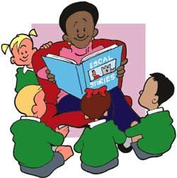
The key elements of a reading programme are
Reading to children
Reading with children
Reading by children

Slide 33
Reading with Children
Today we will focus on:

Slide 34
Poetry in Years 1 and 2
Poem Books are taken home every Friday and your child can share the Poem of the Week with you.

Slide 35
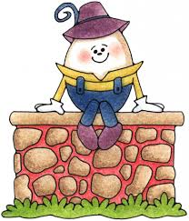
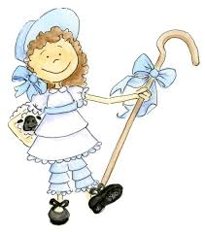
Early Literacy Skills
When children are acquiring early literacy skills, they should be given resources that give them success, enjoyment and understanding at this early stage.
One such resource is Rhymes and poems.
Read the rhyme ‘Pat-a-cake’.
Discuss the sounds and sight word
children would learn in the rhyme.

Slide 36
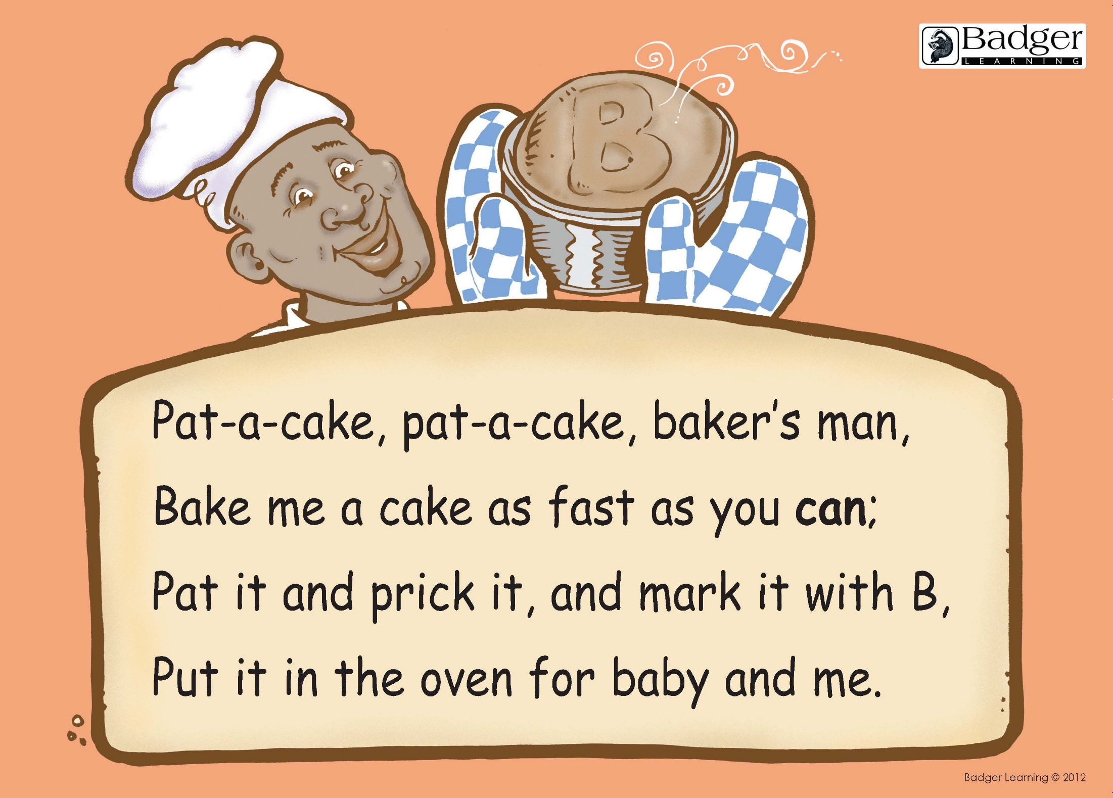
Early Literacy Skills
For children to learn to read they should be given resources that give them success, enjoyment and understanding at this early stage.
One such resource is nursery rhymes and pre reading rhymes.
Humpty Dumpty

Slide 37
Poems and Rhymes introduce children to:
Connections between print and speech
Early reading skills: where to start, pointing and matching, print moves from left to right, print=meaning
High frequency words
Phonics
New interest words
Punctuation
Expressive reading
New knowledge and understanding of the world
Interest words that will extend their vocabulary
Early comprehension skills

Slide 38
An Autumn Greeting
“Come”, said the Leaves to the Wind one day.
“Come over the meadow and we will play.
Put on your dresses of red and gold.
For summer is gone and the days grow cold.”
This Photo by Unknown Author is licensed under CC BY-SA-NC
This Photo by Unknown Author is licensed under CC BY-NC

Slide 39
An Autumn Greeting Year 1
Discuss the learning
in the poem

Slide 41
The Hungry Fire Year 2
Discuss the learning
in the poem

Slide 42
Reading Rhymes and Poems in School
Rhymes and poems will be introduced in class for the children to learn together. They will be used to teach and reinforce sounds and high frequency words and punctuation. Also, to introduce them to new interest words which will help extend their vocabulary.
There will be opportunities for children to practise the rhyme as well as incorporating it into their learning.
These rhymes and poems have been brought home for the children to share with you

Slide 43
How can you help at home

Slide 44
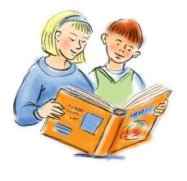
Home-School Balance
Reading with your child is vital. Research shows that it's the single most important thing you can do to help your child's education. It's best to read little and often, so put aside some time for it every day.
School teaches the skills. It is out-of school that children need to practise those skills, to learn to master them.

Slide 45
How can you help at home?
When reading the rhymes with your child here are some suggestions of questions you can ask:
Can you read the rhyme with me?
Can you read this rhyme on your own and point to each word when you read?
Can you point and read a word that you know? (Word of the Week).
Can you find the first and last letter in the word?
Can you find the first and last letter in the poem?

Slide 46
Celebrating your child’s home language
Children should be encouraged to chant rhymes they know in their home language and share them with the other children in the class.

Slide 47
Poem Point (1)
Point to the start or title and recite the poem.
Point to sight words and a new word (discuss its meaning).
Point to the punctuation in the poem.
Point to the sounds in the poem you know.
Point to the rhyming words. What type of rhyme is it?

Slide 48
Use 5 fingers to:
Point to the start or title and recite the poem.
Point to sight words and a new word (discuss its meaning).
Point to the punctuation in the poem.
Point to the sounds in the poem you know.
Point to the rhyming words. What type of rhyme is it?

Slide 49
The ‘Do’s for successful reading at home
Preparing
The Right Place It is comfortable. It is private and quiet. It is where you won’t be interrupted. It is where you can sit beside your child. The Right Time It is when you are relaxed. It is when your child is relaxed. It is when you can both give all your attention to the reading. The Right Manner It is positive.

Slide 50
The ‘Do’s for successful reading at home
Praising Praise makes your child feel good about themselves, makes your child feel good about reading, makes them want to try harder, lets them know what they are doing right. Praise, praise, praise, praise and praise again! Pausing Pausing gives the child time to work things out for themselves, gives you time to think how to help. Try never to do anything for your child that they can do for themselves. Probing The purpose of reading is to get meaning.

Slide 51
The ‘Don’t’s for successful reading at home
Comparisons
Every child is different, reading development can vary enormously from child to child. Try not to compare children.
Anxiety
Try not to worry about child’s reading development. The teacher will contact you should there be any concerns. Children pick up on their parent’s anxieties.
Covering the pictures
Children are taught to read using the pictures. Reading is about meaning.
Belief: “If it’s not hurting, it’s not working!”
Fluent readers don’t always need harder books.
They need a deeper understanding.

Slide 52
My 5 Finger Retell for Emergent Readers
Retell the story using your 5 fingers.
Thumb: Characters in the story are……..
Pointer: The setting is (e.g. home, school, farm, park etc.)
Tall Finger: The book was about………
Ring Finger: Point to a picture you liked and talk about it.
Little Finger: Did you like the story? Why? Or Why not?

Slide 53
Five-Finger Retell
Story
Setting
Picture
Discuss
Characters

